Slide 1
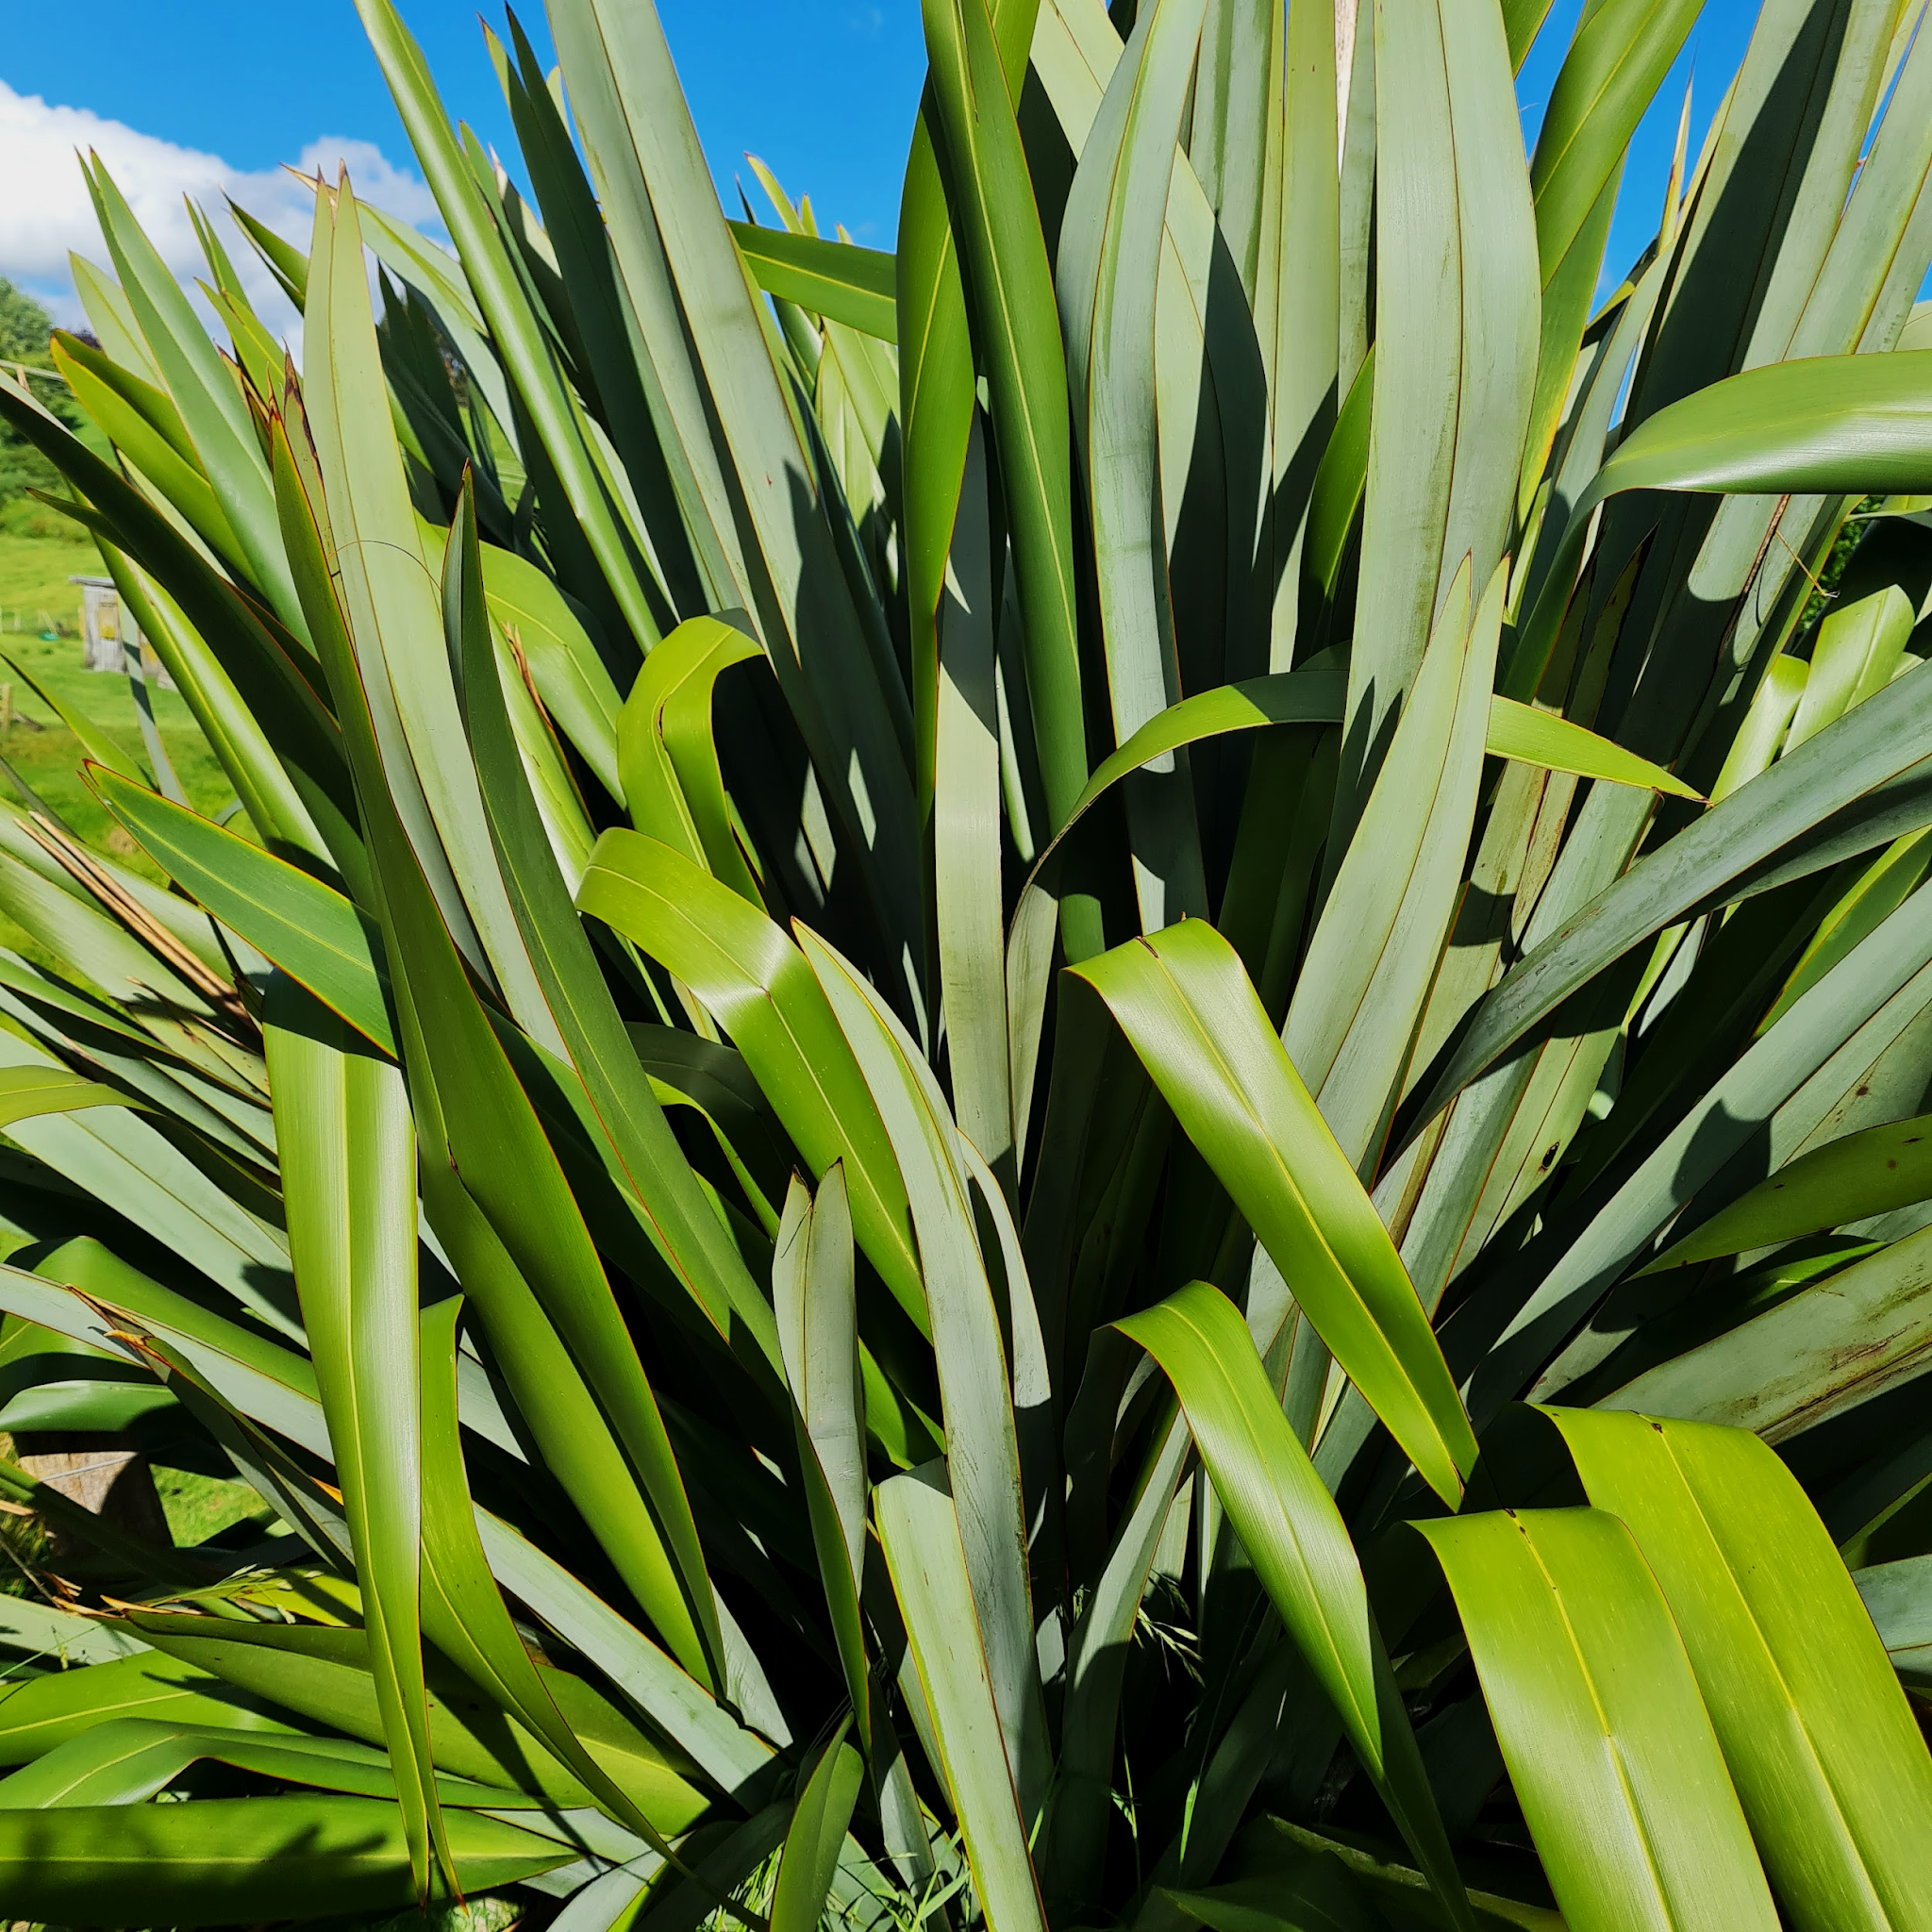


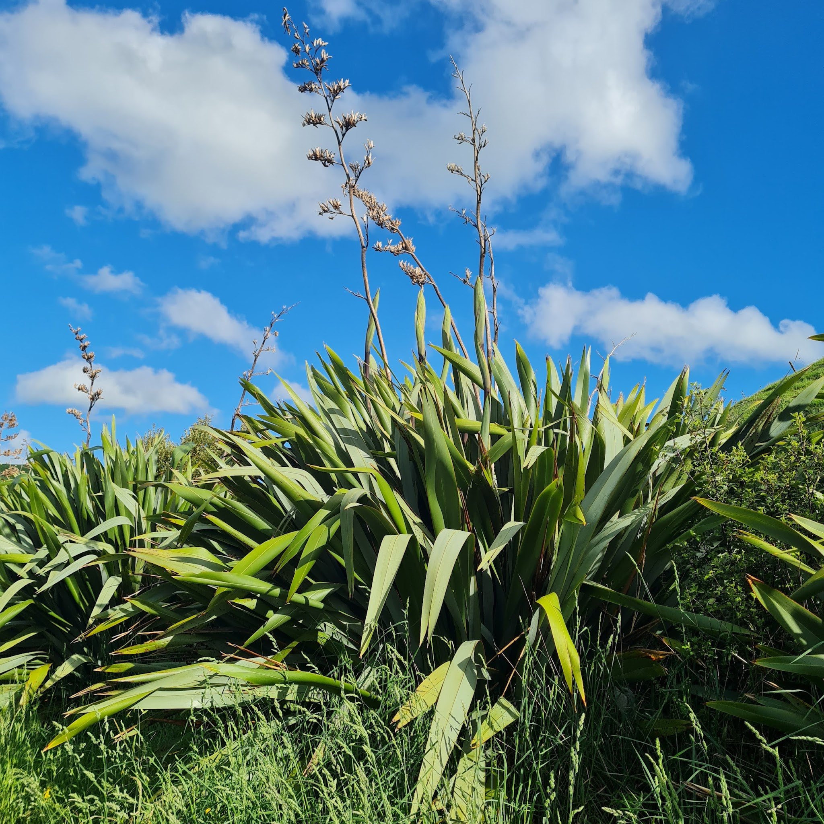

He Pā Harakeke
A socio-ecological
process to support transformative change in education for a thriving Aotearoa New Zealand.
The ASSEN/NZHTA resource “HE PĀ HARAKEKE” was conceptualised in 2022 by Kaiārahi Māori Kārena Ngata to support the implementation of Te Ao Tangata. HPH has since been refined by the ASSEN and NZHTA teams who believe it has the potential to be useful in implementing the broader change programme in the refreshed curriculum. This work is licensed under the Creative Commons Attribution-NonCommercial- ShareAlike 4.0 International License. PLEASE MAKE A COPY AND SAVE TO YOUR DRIVE.
Notes:
INTRODUCTION: Designed as an implementation tool for the refreshed Social Sciences Curriculum, ASSEN and the NZHTA believe He Pā Harakeke may also be useful in implementing the broader refreshed curriculum and supporting the change programme. During this workshop, Teachers will be introduced to the metaphor and will then be asked to work in pairs or threes to engage with an element of HPH.
They will then present their engagement with the element back to the wider group.
CREDIT: THE METAPHOR of HE PĀ HARAKEKE was conceptualised by Kārena Ngata, Kaiārahi Māori for ASSEN and NZHTA, and has been refined with input from the ASSEN Team. He Pā Harakeke is yours to adapt to your own contexts, but please acknowledge ASSEN and NZHTA Networks of Expertise.
Ngā mihi, Kārena.

Slide 2
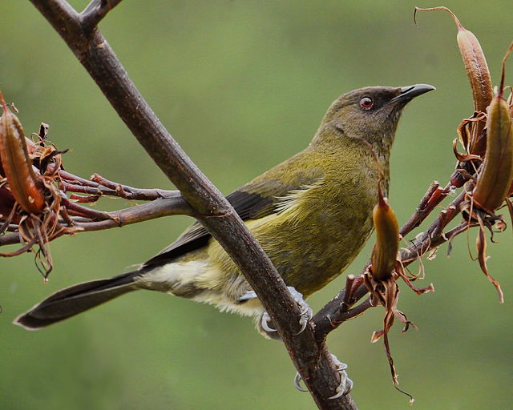
He Pā Harakeke
Unuhia te rito o te harakeke kei whea te kōmako e kō?
Whakatairangitia –
rere ki uta, rere ki tai;
Ui mai koe ki ahau
He aha te mea nui o te ao?
Māku e kī atu, he tangata,
he tangata, he tangata!
Ko te whakatau-aki
A New Zealand Bellbird in New Zealand. Sid Mosdell from New Zealand Creative Commons Attribution 2.0
Meri Ngāroto, Nō Te Aupōuri.
Notes:
5 MINS
THE SOCIAL SCIENCES WHAKATAUAKI
Accredited to Meri Ngāroto Nō Te Aupōuri, this whakatauāki can be translated as:
Remove the heart of the flax bush and where will the bellbird sing?
It will mill around, it will fly inland, it will fly seawards.
If you ask me ‘What is the greatest thing in the world?’
I will reply, ‘It is people, it is people, it is people!’ scenes

Slide 3
He Pā Harakeke
Remove the heart of the flax bush and where will the bellbird sing?
It will mill around, it will fly inland, it will fly seawards.
If you ask me ‘What is the greatest thing in the world?’
I will reply, ‘It is people, it is people, it is people!’
Ko te whakatau-aki
INTERPRETING THE MESSAGE:
For me this whakatauaki is about the importance of place, interrelatedness and connectedness. It speaks to the protection and nurturing of our up and coming generations and the interdependent relationships they have with their environment and the environmental systems around them which are paramount to the holistic wellbeing of humanity. It also speaks to me about the interconnected nature of Mātauranga ā-Iwi and other indigenous knowledge systems.
He Pā Harakeke (HPH) was designed as a metaphor to conceptualise both the complexity and the coherency of the multiple research based elements required to support transformative change when implementing the refreshed Social Sciences curriculum. Kārena Ngata, 2023.
Meri Ngāroto Nō Te Aupōuri
Notes:
5 MINS
THE SOCIAL SCIENCES WHAKATAUAKI
INTERPRETING THE MESSAGE:
For me this whakatauaki is about the importance of place, interrelatedness and connectedness. It speaks to the protection and nurturing of our up and coming generations and the interdependent relationships they have with their environment and the environmental systems around them which are paramount to the holistic wellbeing of humanity. It also speaks to me about the interconnected nature of Mātauranga ā-Iwi and other indigenous knowledge systems.
He Pā Harakeke (HPH) was designed as a metaphor to conceptualise both the complexity and the coherency of the multiple research based elements required to support transformative change when implementing the refreshed Social Sciences curriculum.

Slide 4
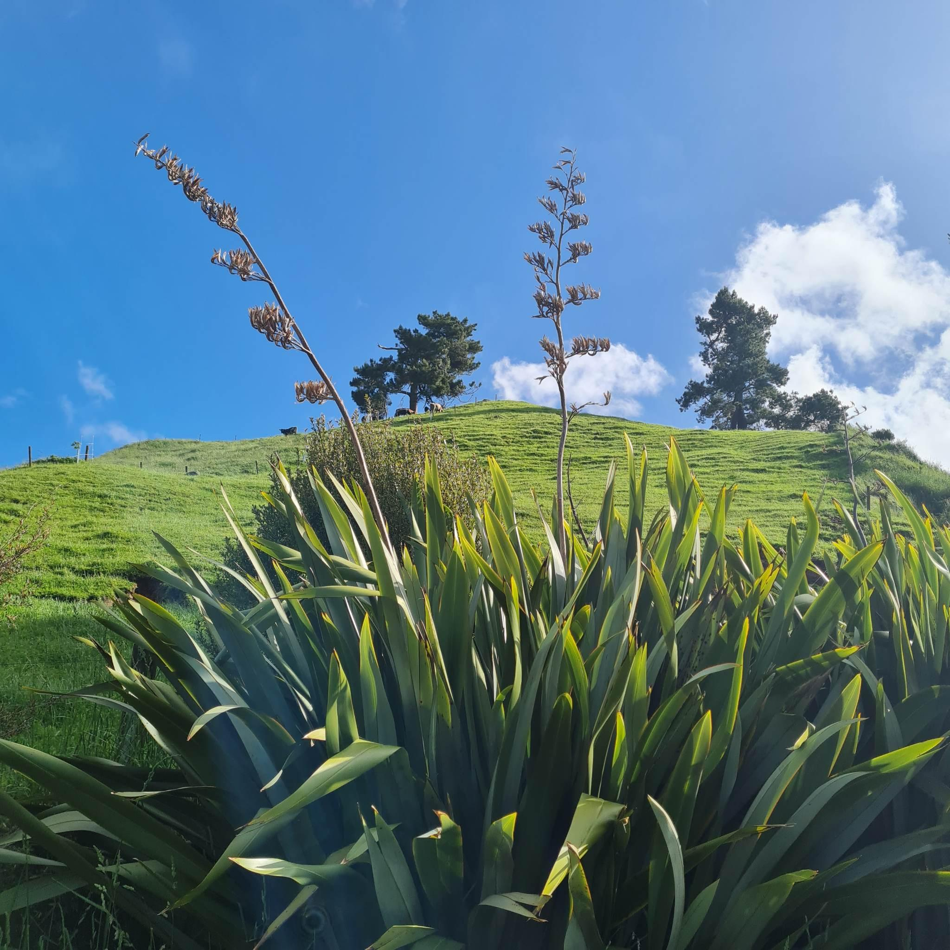
He Pā Harakeke
ĀWHI RITO / Supporting Leaves - Parents, Guardians, Whānau, Kaiako
TĪPUNA / Outer leaves - Experts
eg Tangata Whenua, Mentors
RITO / Central shoot - Learner
(PĀ) HARAKEKE /
Whole plant(ation)
- Broader learning community
TIKANGA / Practices
Culturally Responsive &
Sustaining Pedagogies
KŌRARI /Flower stalk
Learning Journey
TUAKA / Spine of Leaf
- Te Tiriti o Waitangi
PUĀWAI / Flowers
Learning products / output
PAKIAKA/ Root System
- Theories, Ethics and Principles
HAENGA WHAKAWHITI / Cross pollination - Integrated learning, connected curriculum
WHENUA / Land - Localised learning, tūrangawaewae,
environment
KĀKANO / Seeds - Inspiring new inquiry, continuity of learning
Notes:
Metaphor extended on next slide.

Slide 5
He Pā Harakeke - THE METAPHOR
ĀWHI RITO / Supporting Leaves - Parents, Guardians, Whānau, Kaiako
TĪPUNA / Outer leaves - Experts
eg Tangata Whenua, Mentors
The WHENUA needs to have been
nourished so that is its in a state capable of
generating growth. The PAKIAKA, or root system
needs to be extensive to support the entire plant. The
leaves are parallel-sided with a central TUAKA, or spine,
providing structure in the middle. The outer leaves of the fan are the TĪPUNA (ancestors), the inner leaves are the Parents or ĀWHI RITO. The most inner leaf is the RITO, or Pepe (Baby). Our TIKANGA dictates that when you harvest harakeke, only the Tīpuna are cut as the Ahwi Rito are essential to protect the Rito. If the Rito perishes, so does the whole PĀ HARAKEKE, because the parts of the plant are interdependent, not only on each other but also on the environment for survival. From the centre of the fan, the KŌRARI grows up to five metres tall. The PUĀWAI, or flowers are designed to attract pollinators such as the Bellbird (Kōmako). It is their presence that ensures the HAENGA WHAKAWHITI, needed to fertilise and create the harakeke KĀKANO (seeds). The seed pods are shaken by the winds, the seeds released and they drop to the soil to germinate, contributing
To the development of a PĀ HARAKEKE,
a thriving community.
RITO / Central shoot - Learner
(PĀ) HARAKEKE /
Whole plant(ation)
- Broader learning community
TIKANGA / Practices
Culturally Responsive &
Sustaining Pedagogies
KŌRARI /Flower stalk
Learning Journey
TUAKA / Spine of Leaf
- Te Tiriti o Waitangi
PUĀWAI / Flowers
Learning products / output
PAKIAKA/ Root System
- Theories, Ethics and Principles
HAENGA WHAKAWHITI / Cross pollination - Integrated learning, connected curriculum
WHENUA / Land - Localised learning, tūrangawaewae,
environment
KĀKANO / Seeds - Inspiring new inquiry, continuity of learning
Notes:
10 MINS
THE METAPHOR - He kōrero nā Kārena:
The WHENUA needs to have been nourished so that is its in a state capable of generating growth. The PAKIAKA, or root system needs to be extensive to hold the entire plant. The leaves are parallel-sided with a central TUAKA, or spine,
providing structure in the middle. The outer leaves of the fan are the TĪPUNA (ancestors), the inner leaves are the Parents or ĀWHI RITO. The most inner leaf is the RITO, or Pepe (Baby). Our TIKANGA dictates that when you harvest harakeke, only the Tīpuna are cut as the Ahwi Rito are essential to protect the Rito. If the Rito perishes, so does the whole PĀ HARAKEKE, because the parts of the plant are interdependent, not only on each other but also on the environment for survival. From the centre of the fan, the KŌRARI grows up to five metres tall. The PUĀWAI, or flowers are designed to attract pollinators such as the Bellbird (Kōmako). It is their presence that ensures the HAENGA WHAKAWHITI, needed to fertilise and create the harakeke KĀKANO (seeds). The seed pods are shaken by the winds, the seeds released and they drop to the soil to germinate, contributing to the development of a PĀ HARAKEKE, a thriving community.

Slide 6
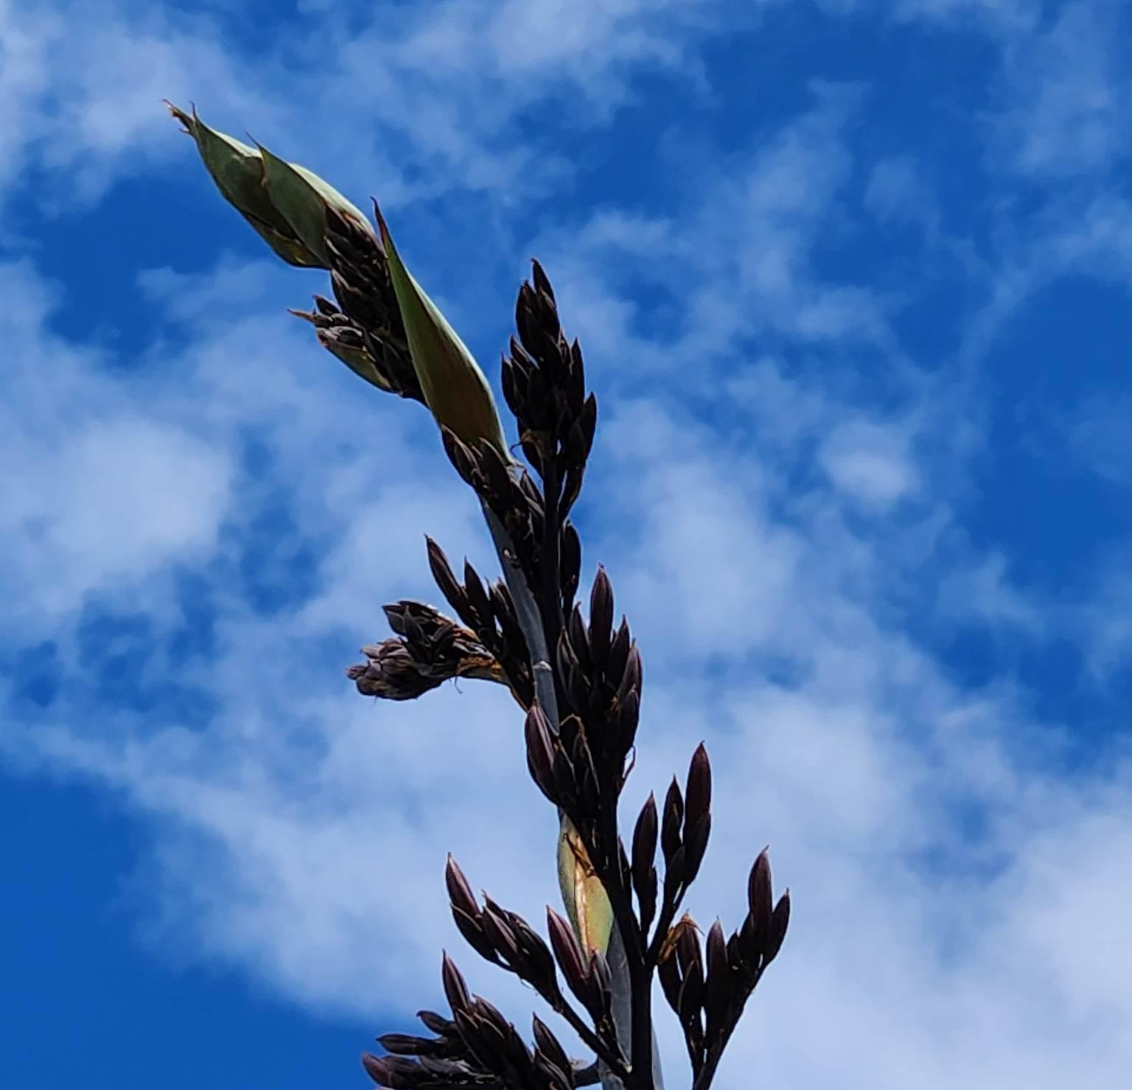
Unpacking He Pā Harakeke
Kia āta titiro:_
NGOHE AKO - IN SMALL GROUPS, CHOOSE 2-3 WAYS TO ENGAGE WITH THE ONE ELEMENT YOU ARE ALLOCATED (7MINS):
Paraphrase THE ELEMENT’S SUMMARY.
CONSTRUCT A FURTHER PROVOCATIVE PĀTAI THAT IS RELEVANT TO YOUR CONTEXT. BE DELIBERATELY DISRUPTIVE.
Connect THE ELEMENT WITH ONE OR TWO OTHER ELEMENTS OF HE PĀ HARAKEKE OR WITH TUAKA SPECIFICALLY.
Exemplify THE ELEMENT IN YOUR CONTEXT IE:
“WHAT DOES/MIGHT THIS LOOK LIKE FOR OUR CLASSROOM/ SCHOOL / KĀHUI AKO?”
PRESENT ONE OR MORE OF THE ABOVE TO GROUP (3 MINS).
Notes:
Participants are given 7 minutes to engage with their element (2-4 persons per element is ideal).
Participants may choose at least two of the tasks (Paraphrase; Construct; Connect; Exemplify) to complete in the 7 mins.
Participants present their engagement to the wider group in 3 minutes.
Facilitator to show slide 8 (Whenua) and then slide 9 where Whenua is completed as an example HEI TAUIRA.
12 elements, allow 5 mins for presentations and transitions = 60mins

Slide 7
WHENUA / Land -
Local contexts, tūrangawaewae, learning environment
This could be about:
Designing a local curriculum that is unique and responsive to the priorities, preferences, and issues of your community and your people. MoE
Prompting questions might include:
How do we ensure that the full extent of the New Zealand Curriculum is expressed in our local curriculum?
How do we work with our school community to get some shared understandings about the teaching and learning we would like at our school?
What stories are told about the people, events, and changes that are important to people in this area?
How will our curriculum explore our place and our relationship with it?
Resources and readings that may be helpful:
Local Curriculum / Strategic Planning / Tool Local curriculum: Designing rich opportunities Whose voices help to shape your local curriculum? Innovative learning environments | Academic paper: Colonisation, Hauora and Whenua in Aotearoa NZCER: interrelatedness and whanaungatanga Effective approaches to connect children with nature Place-based education - PENETITO reader Pūtātara - Tūrangawaeawae
Notes:
The activity outlined on the previous slide is exemplified for this element on the next slide.

Slide 8
WHENUA / Land - Local contexts, tūrangawaewae, learning environment
JIGSAW ACTIVITY- HEI TAUIRA (EXAMPLE) FOR THE ELEMENT “WHENUA”
Paraphrase summary: “Creating a specialized curriculum tailored to the distinct needs, desires, and challenges of your local community and its residents.”
Construct: How might we support the self-determined aspirations of mana whenua?
Connect: RITO - empowering and relevant learning as ākonga connect with their own agency in the co-construction of a curriculum that they can see themselves in; TIPUNA - learning about Tūrangawaewae is learning best facilitated by or with local tangata whenua. TUAKA - Within the kaupapa of localising the curriculum lays a critical opportunity to honour the mana motuhake of your local tangata whenua. TIKANGA - Employing a critical pedagogy of place helps to decolonise our thinking about our landscapes and the storied histories they hold.
Exemplify: TIKANGA: We conduct a history walk around the area our school is located; RITO: Relevance - many ākonga whakapapa to this whenua and all walk this land every day; TĪPUNA: Original names and narratives around historical land use are emphasised so that students can connect with what once was, not just what it is now; TUAKA: Our local tangata whenua designed the walk and trained kaiako to conduct it - they want people to know the history of the whenua our town is on.
Present: Determine key messages and deliver this to the wider group in under 3mins
eXAMPLE
Notes:
JIGSAW ACTIVITY (HEI TAUIRA - EXAMPLE): 7 mins to do 2 or 3 of these activities.
Paraphrase summary: “Creating a specialized curriculum tailored to the distinct needs, desires, and challenges of your local community and its residents.”
Construct: How might we support the self-determined aspirations of our mana whenua?
Connect: RITO - empowering and relevant learning as ākonga connect with their own agency in the co-construction of a curriculum that they can see themselves in; TIPUNA - learning about Tūrangawaewae is learning best facilitated by or with local tangata whenua. TUAKA - Within the kaupapa of localising the curriculum lays a critical opportunity to honour the mana motuhake of your local tangata whenua. TIKANGA - Employing a critical pedagogy of place helps to decolonise our thinking about our landscapes and the storied histories they hold.
Exemplify: TIKANGA: We conduct a history walk around the area our school is located; RITO: Relevance - many ākonga whakapapa to this whenua and all walk this land every day; TĪPUNA: Original names and narratives around historical land use are emphasised so that students can connect with what once was, not just what it is now; TUAKA: Our local tangata whenua designed the walk and trained kaiako to conduct it - they want people to know the history of the whenua our town is on.
Present: Determine key messages and deliver this in under 3mins

Slide 9
PAKIAKA/ Root System - Theoretical underpinnings, guiding ethics and principles
This could be about: Embedding Kaupapa Māori Ethics & Principles, Critical Theories and Socio-Cultural Theories in our practice. The adoption of a critical lens is used “to examine the influence of social conditions, global influences and equity of opportunity on children’s learning and development. Critical theory perspectives challenge disparities, injustices, inequalities and perceived norms.” MoE
Prompting questions might include:
What texts shall we look at that will provide rich basis for analysing inclusion, exclusion, and representation?
How might my/our backgrounds – spiritual beliefs, ethnicity, gender, interests, abilities, socio–economic circumstances – be shaping this practice?
How do we design activities that uses maths to develop critical awareness about wider social, environmental, political, ideological, and economic issues?
How is the unique history and worldview of ākonga whānau – connections to maunga, awa, wāhi tapu, constellations, culture, and history – represented in the (learning) artefacts and curriculum?
Resources and readings that may be helpful:
Critical theories | Te Whāriki Online The Common Practice Model Sociocultural Theories | Te Whāriki A Theory of Planetary Social Pedagogy | Poutama Pounamu On Critical Theories Activating Critical Theories Linking Kaupapa Māori Theories Unteach Racism

Slide 10
TUAKA / Spine of Leaf - Te Tiriti o Waitangi
This could be about:
“The Treaty of Waitangi principle calls for schools to understand and honour Treaty principles in all actions and decision making. It is about making our country’s bicultural foundations evident in school policies, organisation, physical spaces, whānau and community engagement, and classroom planning and assessment.” MoE
Prompting questions might include:
How does our local curriculum reflect local tikanga Māori, mātauranga Māori and te ao Māori?
How are we implementing Ka Hikitia / Ka Hāpaitia in our school?
How might we embed our TIriti commitment? What challenges might we encounter and how might we respond?
How do we ensure classroom learning helps students understand Te Tiriti o Waitangi – its past, present, and future – and helps them live the treaty as citizens of Aotearoa?
Resources and readings that may be helpful
Treaty Of Waitangi Principle The Māori Education Strategy Te Tiriti in schools - Community Law Groundwork Rauemi | Pounamu On Treaty-Of-Waitangi Mātauranga Māori Giving mana to Tiriti o Waitangi in our schools What Is Māori Achieving Success As Māori

Slide 11
TIKANGA / Cultural practices -
Culturally Responsive and Sustaining Pedagogies (CRSP).
This could be about:
Our understanding that “a culturally responsive and sustaining pedagogical approach values and builds upon the knowledge, values, languages, cultures, identities, whānau, communities, lived experiences, and whakapapa of ākonga”. MoE
Prompting questions might include:
Whose ways of knowing, being, and doing are valued in this practice/decision?
How do we actively redistribute power and status among all members of the learning community?
What teaching approaches enhance outcomes for diverse learners in the social sciences curriculum domain?
How will we support ākonga in acquiring the language and literacies of The New Zealand Curriculum …while maintaining and strengthening their heritage languages?
Resources and readings that may be helpful:
Māori Pedagogies: A View From The Literature | NZCER 14 Culturally responsive pedagogy Cultural diversity principle Te Ahu o Te Reo | Culturally Sustaining Pedagogy Best Evidence Synthesis Tātaiako and Tapasā Action Plan for Pacific Education Wellbeing For Success: Effective Practice

Slide 12
RITO / Central shoot - Learner
This could be about:
How “All students are active, capable learners with unique potential. However, students demonstrate competence in a range of ways and progress at different rates. A key role of the teacher is to really get to know their students, so that they can help them to recognise their competencies, demonstrate their strengths, and work towards their aspirations.” MOE
Prompting questions might include:
How do I encourage each student to participate in learning?
How do I acknowledge each student’s strengths and support their development?
How do I use a growing knowledge of my students to make connections to their prior learning and enhance the relevance of new learning?
How does my teaching impact on my students?
Resources and readings that may be helpful:
High expectations principle Inclusion principle Learning to learn principle Curriculum Accessibility Developing An Inclusive Classroom Culture Learner agency | Supporting Positive Peer Relationships Supporting Pacific Learners Knowing all students Education matters to me: Key Insights Wellbeing For Success: A Resource For Schools

Slide 13
ĀWHI RITO / Supporting leaves
Parents, Guardians, Whānau, Kaiako
This could be about:
How engagement increases when school leaders… are committed to working in partnership with the parents and whānau of all students. MOE
Prompting questions might include:
How do we support strong engagement conditions of whānau?
In what ways are families/whānau able to determine how they will participate in and contribute to our school?
How do we develop School conditions that support parents, whānau, and students to be active partners in learning?
Resources and readings that may be helpful:
Information Sharing And Building He Piringa Whānau Collaborative Planning For Learning Adopt collaborative approaches that have the most positive impact | Education Provision Responds To Learners Within The Context Of Their Whānau Educationally powerful connections with parents and whānau Education for Māori: Relationships between schools and whānau

Slide 14
TĪPUNA / Outer leaves - Experts, Tangata Whenua, Mentors
This could be about:
How involving whānau, hapū, iwi and other local community entities can bring in-school and out-of-school learning together to support valued outcomes for rangatahi.
Prompting questions might include:
How is the body of knowledge that sits within our Māori and Pasifika communities acknowledged and represented in our school?
How do/can the goals and aspirations of the school align with those of the whānau, hapū iwi and Pasifika Communities? What will it take to get a more aligned approach? What benefits might this bring?
Resources and readings that may be helpful:
Partnering With Parents, Whānau, And Communities | Developing Collaborative Connections Between Schools And Māori Communities Whānau, hapū, iwi, Māori communities and schools working together | Connecting With Māori Communities: Educationally Powerful Connections With Māori What an inclusive school looks like Working as a community / Working together / Implementing an inclusive curriculum / Inclusive practices /

Slide 15
PĀ HARAKEKE Whole plant(ation) Broader learning community
This could be about:
“Our community engagement principle isn't just about holding regular whānau hui or having an open door policy. The community engagement principle calls for schools to build productive partnerships with parents, whānau, hapū, and iwi to engage their support and ensure that teaching and learning meets the needs, interests, and talents of their children.” MoE
Prompting questions might include:
●We know there are amazing people doing amazing things in our community. How do we better connect our students to these learning opportunities?
● How can we support interactions and connections between students and their whānau with supporting people and agencies outside of the school?
Resources and readings that may be helpful:
Community engagement principle About Inclusive Education Partner With External Agencies And Organisations With Expertise In Inclusive Practices | Community engagement and the New Zealand Curriculum Partnerships between home and community | Education Review Office

Slide 16
KŌRARI /Flower stalk - Learning journey
This could be about:
Design learning to meet the diverse and variable needs of all students in your classroom.
Prompting questions might include:
How can I incorporate UDL Principles into my classroom learning?
How will we use our knowledge about our students to design learning opportunities that are authentic and relevant to their lives?
How can we design challenging, rigorous learning opportunities for our students that will help them progress and be successful?
Can all our students answer the following questions: What are you learning? Why are you learning it? How well are you doing? Where do you need to go next?
Resources and readings that may be helpful:
What's Changing? | Curriculum Refresh Universal Design For Learning | Inclusive Education Leading local curriculum design in the revised technology learning area: | UDL / Spotlights / Curriculum Resources / Kia Ora Student Inquiry And Curriculum Integration Connecting Universal Design for Learning With Culturally Responsive Teaching Learning design – How the people-based design process works

Slide 17
PUĀWAI / Flowers - Learning product / output
This could be about:
How Curriculum progressions emphasise where a student is on their learning journey and the progress they are making, rather than whether they have achieved (passed or failed) a standard.
Prompting questions might include:
How well does effective “of the moment” assessment for learning underpin teaching and learning in our school?
How well can we locate a student’s performance across the breadth of the curriculum and along a continuum of curriculum levels?
How are student agency and assessment capability being grown across the school?
What tools might we design to strengthen how we notice, recognise, and respond to ākonga learning in our programmes.
Resources and readings that may be helpful:
Assessment For Learning New Zealand Curriculum Refresh: Progressions Approach Determining How Learning Is Progressing Training module on progressions in Mātaiaho | Using A Range Of Assessment Methods Inclusive Design | Rethinking Assessment Assessment For Learning In Practice Rethinking Learner Progression for the Future Te ao tangata | social sciences | Curriculum Refresh Progression In Action
Notes:
Journaling, learning logs, piece of writing, presentation, art work, waiata, student led conferences - “naturally occurring” evidence.

Slide 18
HAENGA WHAKAWHITI/ Cross-pollination
Integrated learning, connected curriculum
This could be about:
where subjects are viewed as interconnected rather than isolated from one another. “All learning should make use of the natural connections that exist between learning areas” (MoE, 2007,p. 16).
Prompting questions might include:
How do we integrate the principles, values, key competencies, and learning areas in our classroom programmes?
How do we support ākonga to make connections, transfer, and apply new knowledge between new learning and across contexts?
Resources and readings that may be helpful:
Curriculum Integration Curriculum Integration - Senior Secondary Connections / Senior Social Studies / Social Sciences Building Conceptual Understandings | Literacy & Communication And Maths Strategy Literacy And Numeracy Pedagogy Guides Tāraia Te Mahara, Ka Tāraia Ai Te Rākau Carve The Mind Before Carving Your Path Weaving a coherent curriculum

Slide 19
KĀKANO / Seeds -
Inspiring new inquiry, continuity of learning, sustainability.
This could be about:
How we can enrich learning opportunities by ensuring coherence and continuity of learning for ākonga, both over the years and across settings (e.g. schools, kura, clusters, Kāhui Ako and early childhood centres). MoE
Prompting questions might include:
How do we provide clear learning pathways across the learning areas and the curriculum levels?
How do we think learning is carried forward from schooling into other aspects of life?
How will this learning support ākonga to deal with future focussed issues such as those linked to sustainability, globalisation, citizenship and enterprise?
Resources and readings that may be helpful:
Learning From Home Transitions Research Projects Effective Learning Pathways School Leavers’ Toolkit | Guidance For Coherent Pathways Taking A "Future Focus" In Education —What Does It Mean? Future focus Principle and Toolkit

Slide 20
He Pā Harakeke: supporting transformative educational change for a thriving Aotearoa.
“Keep your eyes on the Prize”
MLK
The ASSEN/NZHTA resource “HE PĀ HARAKEKE” was conceptualised in 2022 by Kaiārahi Māori Kārena Ngata to support the implementation of the refreshed Social Sciences Curriculum -
Te Ao Tangata.
HPH has since been refined by the ASSEN and NZHTA teams who believe it has the potential to be useful in supporting the implementation of the broader refreshed national curriculum.
To find out more about HPH please contact ASSEN or NZHTA or email kngata@socialstudiesnz.org.
This work is licensed under the Creative Commons Attribution-NonCommercial- ShareAlike 4.0 International License.
Note: Additional resource links and slides to support a HPH teacher workshop has been added to this version by K.Ngata.
Notes:
CONCLUSION: Kōrero from Kārena:
In Aotearoa, Māori, Pacific Peoples, Migrants, Disabled and LGBTQIA+ have had their educational needs underserved by our current system, pretty much from its inception. The inequitable outcomes produced by our monocultural, monolinguistic, heteronormative education system have led to income inequality, widening the rich/poor divide. The most effective place to disrupt the poverty cycle is through education, and with poverty and sustainability being inextricably linked, the “prize” of a successful curriculum refresh is to achieve nothing less than transformative change towards a shared, sustainable future. But transformative change within and through education is a complex undertaking.
The multifarious demands and expectations placed on NZ Kaiako as we navigate the curriculum refresh can leave us vulnerable to cognitive overload. Many Kaiako are feeling overwhelmed and frustrated. By conceptualising how the multiple elements of transformative educational change work together, we are able to visualise the bigger picture, in a way that speaks to coherence within the complexity.
He Pā Harakeke helps us conceive this complexity in a coherent, socio-ecological framework. It offers a generative process of engagement with the various interconnected elements identified by decades of educational research as being required to transform education. Designed as an implementation tool for the refreshed Social Sciences Curriculum, we at ASSEN and the NZHTA suspect He Pā Harakeke may also be useful in implementing the broader refreshed curriculum and supporting the change programme. Please get in touch if you would like to explore this with us: kngata@socialstudiesnz.org
The ASSEN/NZHTA resource “HE PĀ HARAKEKE” was conceptualised and designed in 2022 by Kaiārahi Māori Kārena Ngata to support the implementation of the refreshed Social Sciences Curriculum - Te Ao Tangata. HPH has been refined by the ASSEN and NZHTA teams who believe it has the potential to support the implementation of the broader refreshed national curriculum. To find out more about HPH please contact ASSEN or NZHTA or email kngata@socialstudiesnz.org
This work is licensed under the Creative Commons Attribution-NonCommercial- ShareAlike 4.0 International License

Slide 21


manaaki mauri
TE KURA TAIAO / RAUTĀWHIRI COLLABORATION
“Ka ora te whenua, ka ora te tangata.”
We invite you to find out more about the Rautāwhiri He Pā Harakeke Pilot Programme HERE. Want to kōrero? Contact Kārena: kngata@rghs.school.nz. Please type “He Pā Harakeke” in the subject line.

