Slide 1

Te Tiriti in Education
Presented by Te Reo a Rohe, PPTA Te Wehengarua
Māori Teacher’s Conference, Sudima Hotel, July 2026
Notes:
8 mins

Slide 2


Kārena Ngata - Te Reo a Rohe Taskforce
Workshop overview:
 | Build on our understanding of what Te Tiriti in action in classrooms, schools and communities looks like
 | Offers practical ideas & strategies for supporting a deeper understanding of Te Tiriti in action Build confidence in Te Tiriti affirming practice and support the facilitation of PLD delivery in your contexts
 | Explores the Te Tiriti Toolkit for ready-to-use resources
Notes:
2mins
This practical and engaging workshop is designed for kaiako and reflects on Te Tiriti o Waitangi everyday practices in the profession.
The workshop will explore clear, accessible ideas that support a deeper understanding of Te Tiriti in action, with a focus on what this looks like in classrooms, schools, and learning communities. The session will provide practical tools and strategies to enhance cultural practice, helping kaiako confidently acknowledge and embed the importance of te ao Māori within Aotearoa New Zealand’s education context.
The workshop also includes a guided look through the Te Tiriti Toolkit, supporting teachers to leave with resources they can use immediately in their own settings.
This is an opportunity to grow your capability, reflect on practice, and strengthen your contribution to equitable, culturally grounded education.

Slide 3

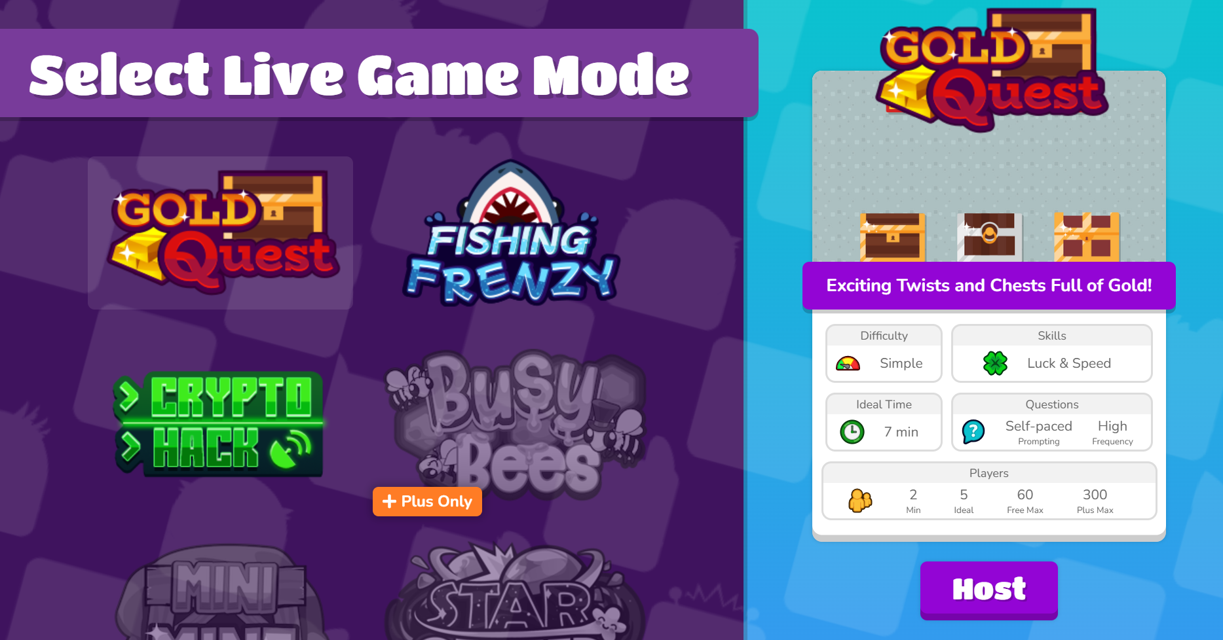
Prior Knowledge - goto play.blooket.com
Notes:
6 mins

Slide 4





CARPARK ACTIVITY:
IF A PĀTAI / QUERY ARISES DURING THE ACTIVITY OR KŌRERO - POP IT ON A POST-IT AND WE
WILL COLLEECT IT & CIRCLE BACK TO IT.
WHY IS THAT…?
DOES THAT MEAN…?
COULD YOU UNPACK THAT A LITTLE FURTHER?
WHAT ABOUT…?
Notes:
2 mins

Slide 5
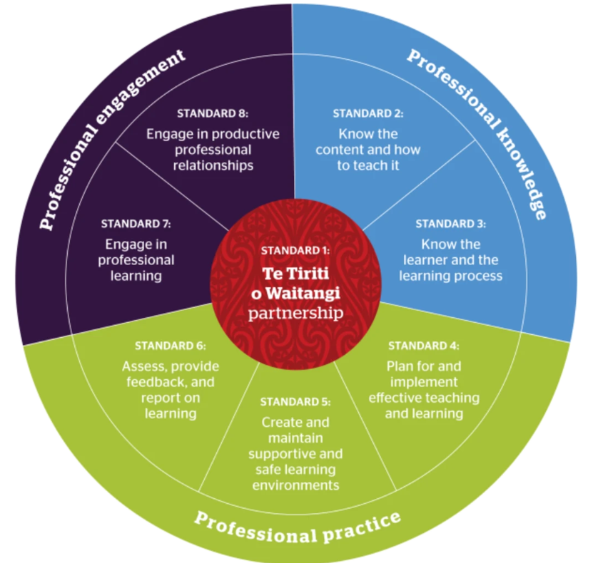

2026
OUR NEW CODE & STANDARDS
Notes:
2MINS

Slide 6
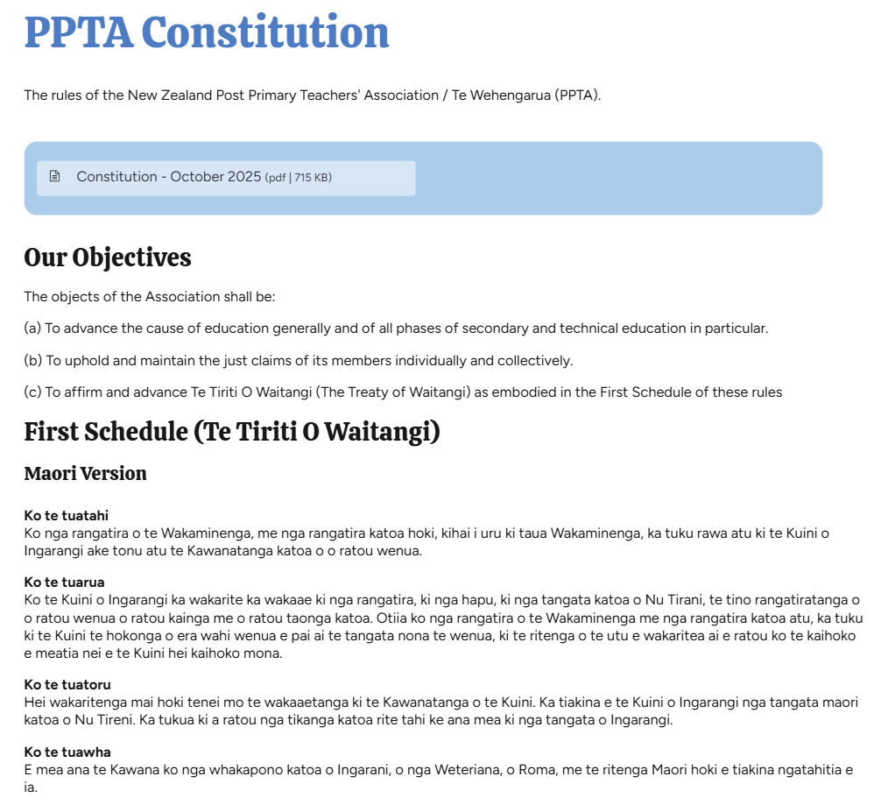

‘To affirm
and
advance
Te Tiriti
o Waitangi’
Notes:
1MINS

Slide 7
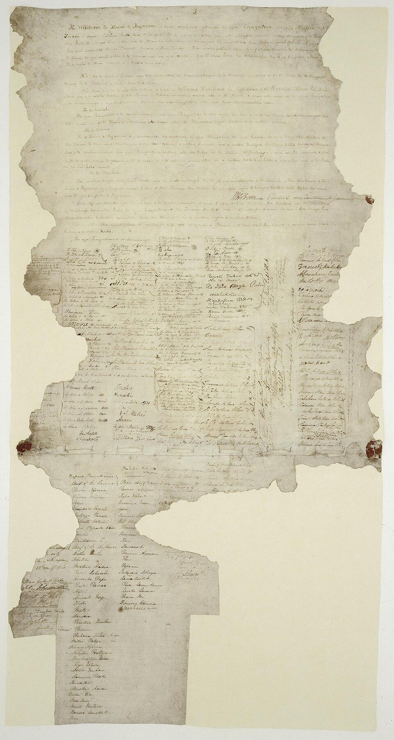

“What is our why?”
Jimmy McLean & Nancy Vercoe
Te Reo a Rohe eastern Bay of Plenty Region
Notes:
2mins
Successful people and organisations do not achieve success by accident. They may have the right skills, systems, structures and strategies in place — but what truly drives sustained success is clarity of purpose. The overriding factor is their WHY
Their WHY shapes the decisions they make. Their WHY guides their behaviour. Their WHY determines what they prioritise. And their WHY keeps them grounded and committed when challenges arise.
Without a clear WHY, even the best plans lose direction.

Slide 8

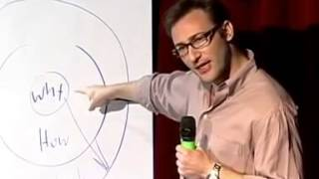
The Golden Circle - Simon Sinek
Notes:
0.32 - 2.50
Simon Sinek is an American author and motivational speaker known for his work on leadership and organisational purpose. He is perhaps most widely recognised for his TED Talk exploring the concept of “Start With Why.”
Here is a short excerpt that helps illustrate what he means by the WHY.

Slide 9
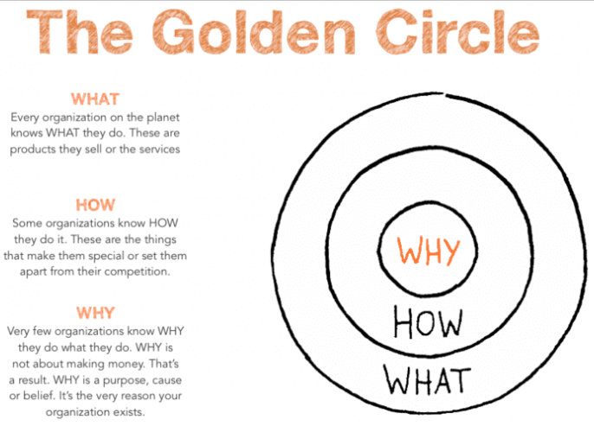
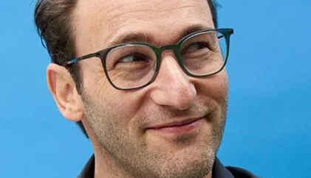
Simon Sinek
Notes:
When we apply this thinking to education in Aotearoa and our obligations under Te Tiriti o Waitangi, understanding our WHY becomes essential. It shapes the purpose behind our actions, guiding how we honour our commitments and support equitable outcomes for all learners.
When our WHY is grounded in honouring Te Tiriti, sharing mana is no longer viewed as a loss of authority. Instead, it becomes a recognition that strong partnerships with Māori strengthen our schools, our communities, and the success of our learners.

Slide 10
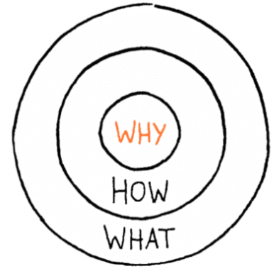
ACTIVITY: So let's explore YOUR WHY…
Choose one of the following questions…
Why did you choose to attend this workshop?
Why should kaiako at your kura advance and
affirm te tiriti?
Why should you (as a kaiako) be te tiriti active?
Take 5 minutes to create/develop your "Why?" A couple sentences max on a post it note is enough. Discuss your "WHY?" with the person next to you if that helps - care to share?
Place your "Why?" under the headings on the wall for us.
Ngā mihi :)
Notes:
10MINS
You can apply this activity to any context… in your class by discussing the relevance of your topic, in a dept meeting, whats your why for this kaupapa? You can ask the questions above to your colleagues who want to explore how to affirm and advance te tiriti?

Slide 11
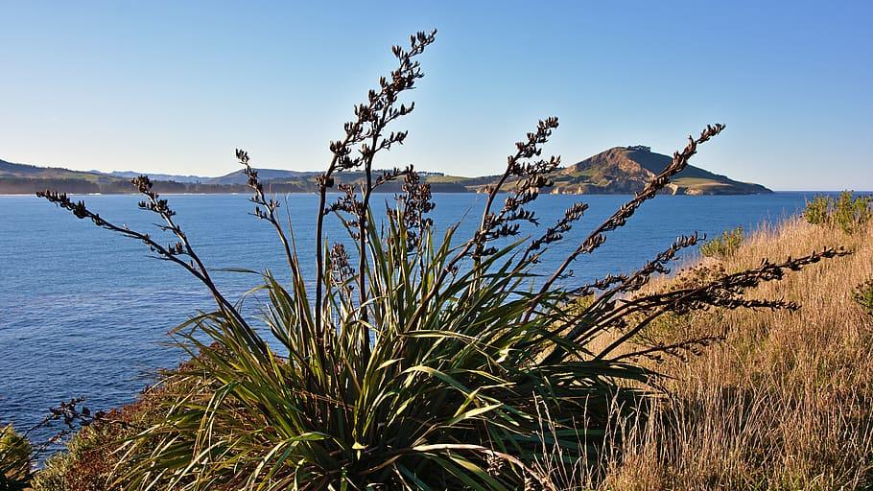
WAIATA

Slide 12
“Hutia te Rito" is a popular Māori waiata that uses the flax plant as a metaphor for whānau, community, the nurturing of new generations, and our interdependence with the natural world around us.
Hutia te rito o te harakeke – pluck out the heart of the flax bush
Kei whea te kōmako e kō? – where will the bellbird sing?
Kī mai ki ahau – I say to you
He aha te mea nui, - What is the most important thing?
Te mea nui o tēnei ao? – most important thing in this world?
Māku e kī atu ki a koe – I will tell you
He tangata, he tangata – it is people, it is people, it is people

Slide 13
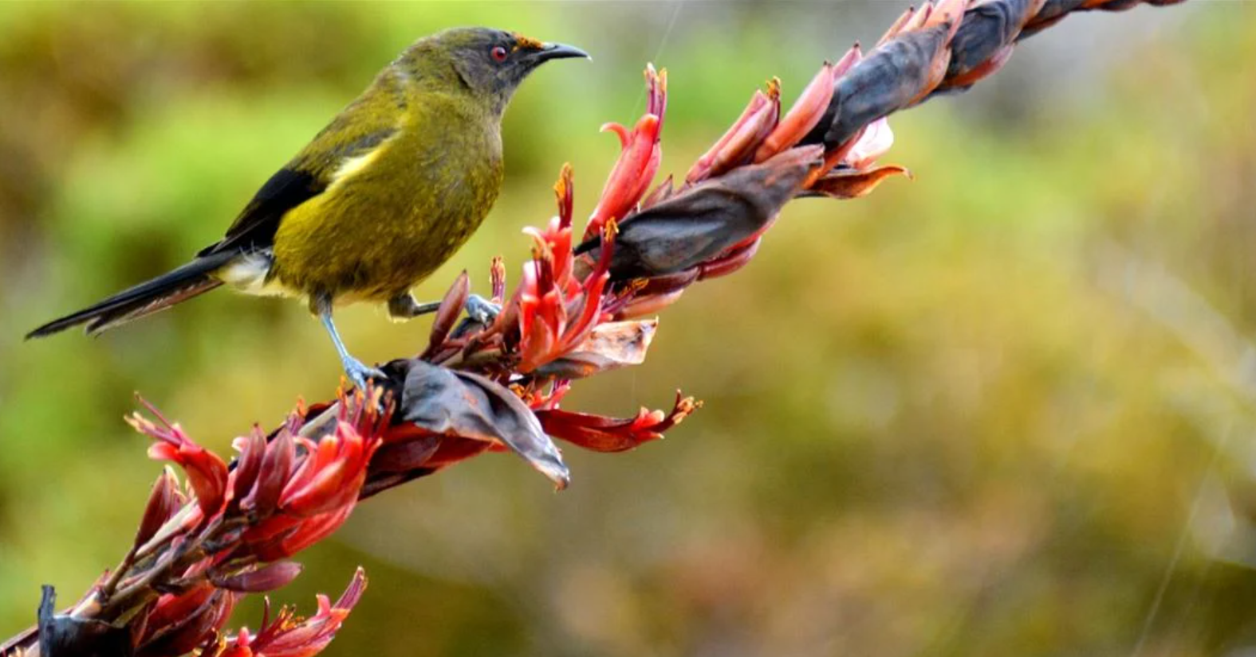
The harakeke (flax plant) represents the community. The central shoot of the flax symbolizes the tamaiti (child), growing between the parents, while the surrounding leaves represent extended whānau. If the Rito perishes, so does the whole plant, because the parts of the plant are interdependent, not only rely on each other, but also on the environment for survival.
The flowers are designed to attract pollinators such as the Bellbird (Kōmako). It is their presence that ensures the cross - pollination needed to fertilise seeds occurs. The seed pods are shaken by the winds and released to drop to the soil to germinate, contributing to the development of a thriving community.
THINK/PAIR/SHARE:
What “messages” are present in this metaphor? How might those messages apply to education?
How might they enhance the teaching and learning we design?

Slide 14
Hūtia te Rito
Hūtia te rito
Hūtia te rito o te harakeke
Kei hea te kōrimako e kō?
Kī mai koe ki ahau:
He aha te mea nui?
He aha te mea nui o te ao?
Māku e kī atu
He tangata! He tangata! He tangata, hī!
Notes:
10MINS
https://menza.co.nz/waiata-hutia-by-hirini-melbourne/
Hutia te Rito – Zachary J. Moore
Karakia-Katoa-Hutia-te-rito-o-te-Harakeke.pdf

Slide 15
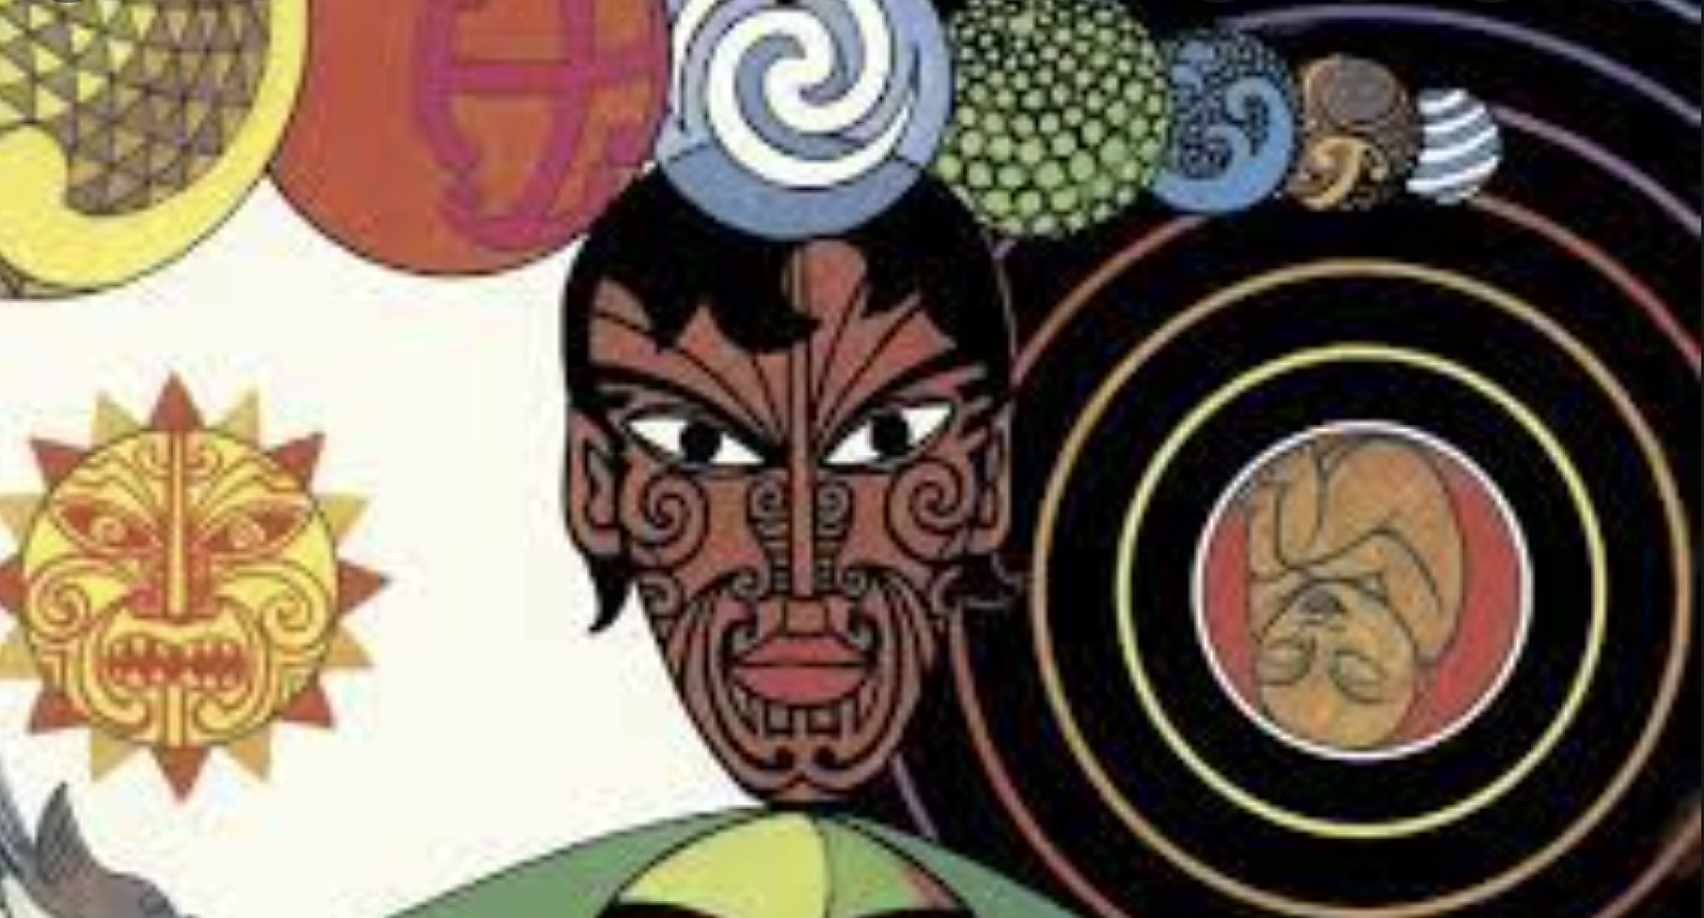
GUESS THE MĀORI ORAL NARRATIVE IN THE SLOOOOOWW
REVEAL

Slide 16
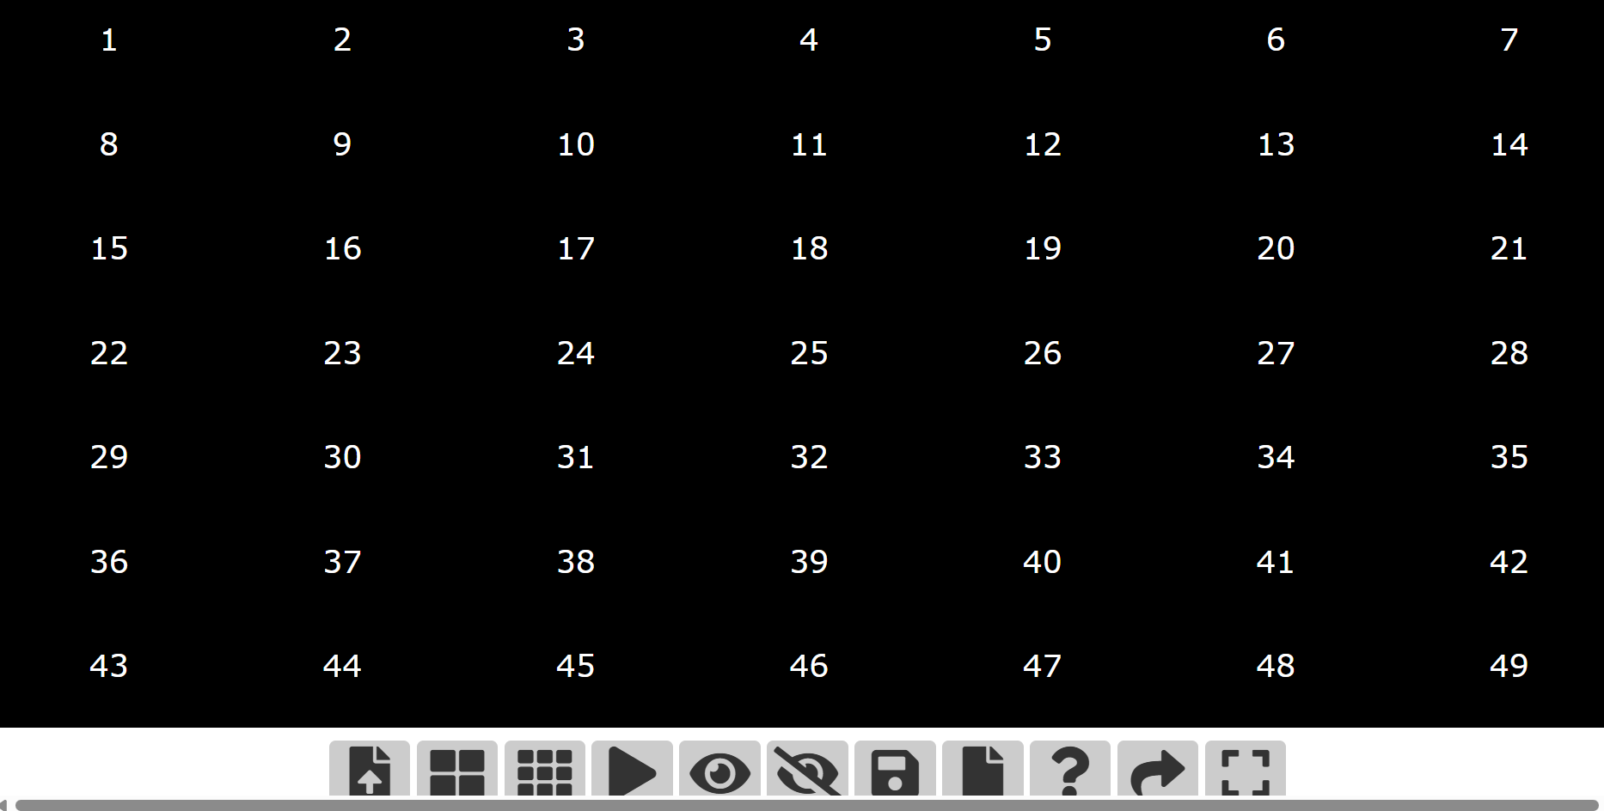
CLASSTOOLS: SLOW REVEAL

Slide 17

Practical ideas & strategies for supporting a deeper understanding of Te Tiriti in action.
Nancy Vercoe (BOP) & Karena Ngata (BOP)
Notes:
1MIN

Slide 18


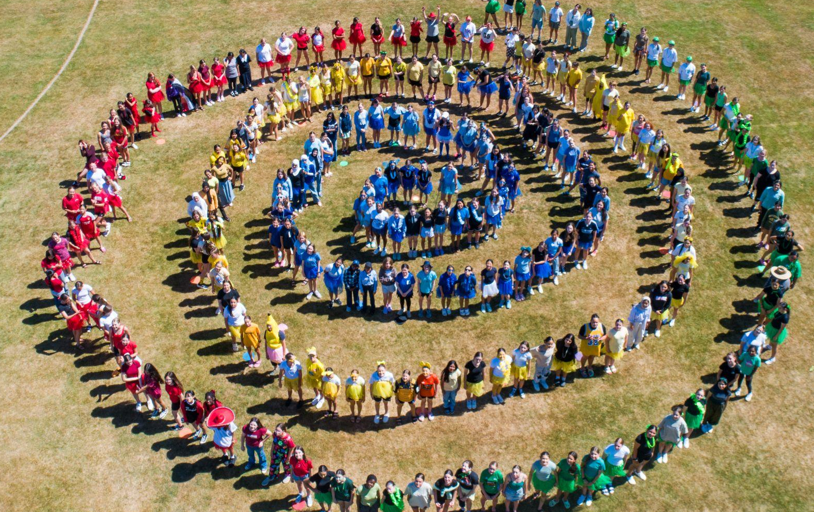
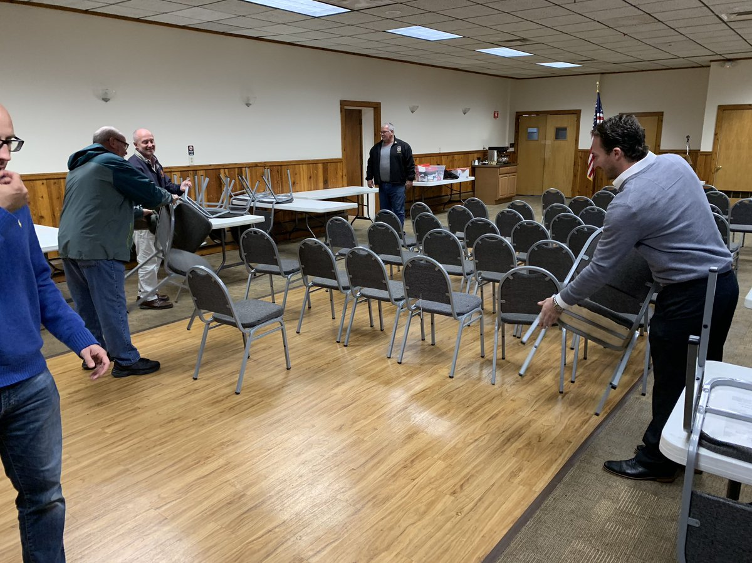
ACTIVITY:
Find an image online (or draw one) that represents what you believe Te Tiriti in action could look like in your class or kura - 5 mins.
Notes:
10MINS
This activity can also be applied in different contexts

Slide 19

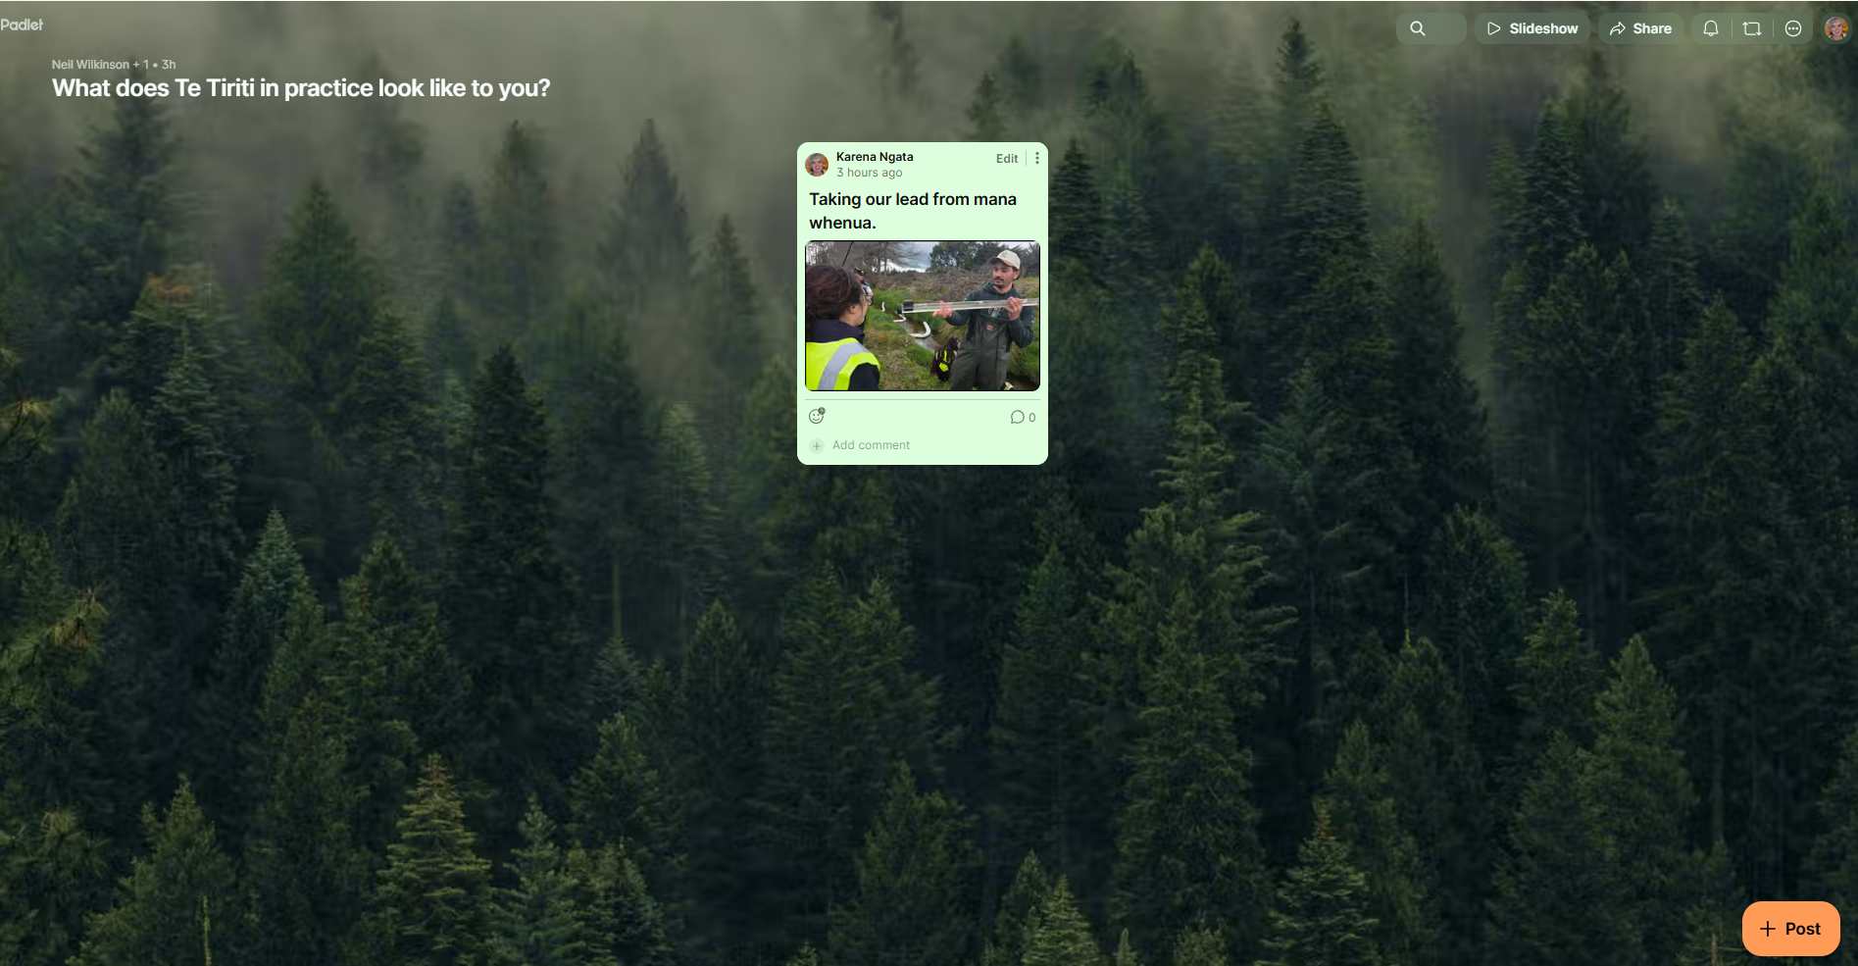
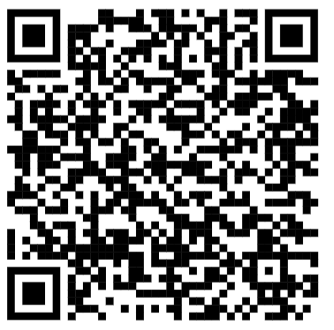
Visit the padlet (using url below or QR code) and share /upload your image that captures what Te Tiriti in practice looks like for you - Thank you for sharing :)
https://bit.ly/40bWG9C
Notes:
5MIN
Save this padlet so you can share with colleagues what Te Tiriti in action could look like - those visual people in our staffrooms ne?

Slide 20
A E I O U
Kēmu - brain break

Slide 21

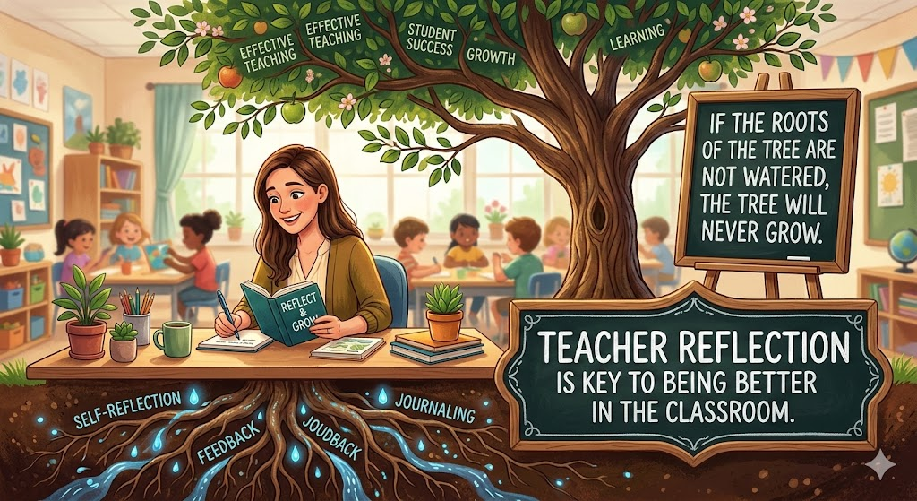
Wayground
CRSP
Ki te kore ngā pūtake e mākūkūngia, e kore te rākau e tupu.
RESEARCH
Notes:
Kahmil: “Ki te kore ngā pūtake mākūkungia e kore te ngākau e tupu”

Slide 22
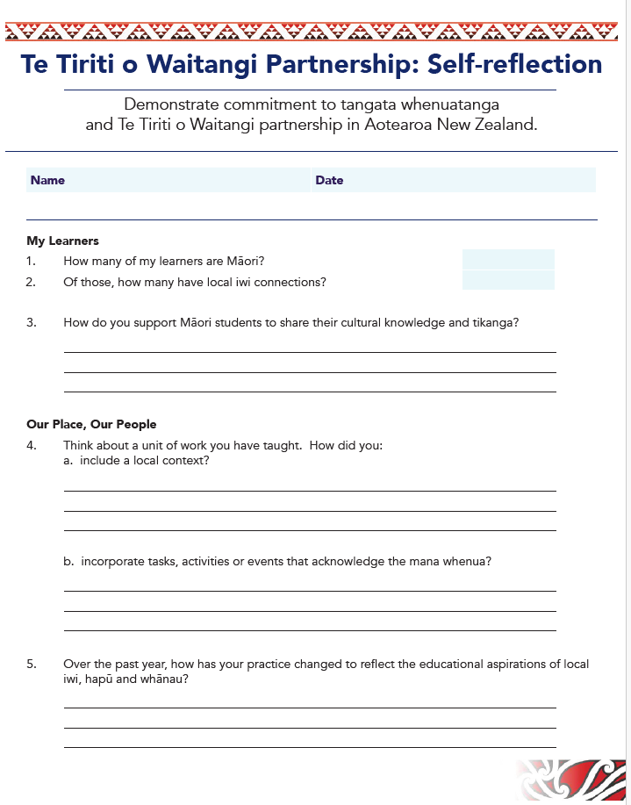
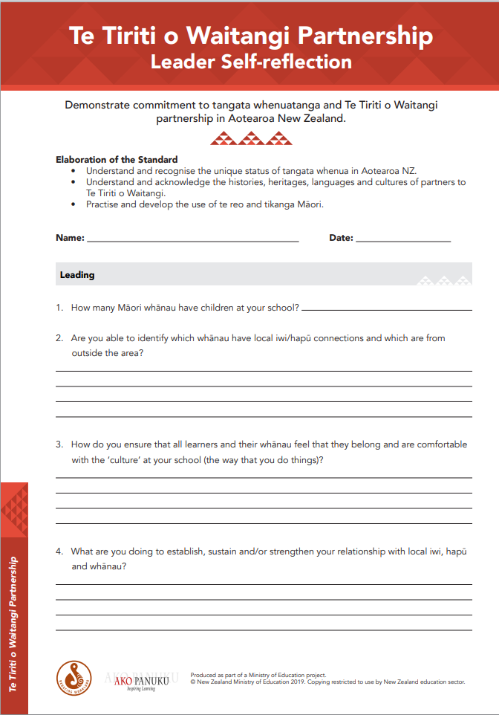

FOR TEACHERS https://akopanuku.education.govt.nz/resources/230/teachers-reflection-tool-english?query=ecf04ce1e389ba92f6ae230338ad8161
FOR SCHOOL LEADERS
https://assets.akopanuku.apps.astonjames.co.nz/public/ResourceFiles/Resource_Leader-Self-reflection-Tiriti-o-Waitangi-Partnership_File.pdf

Slide 23
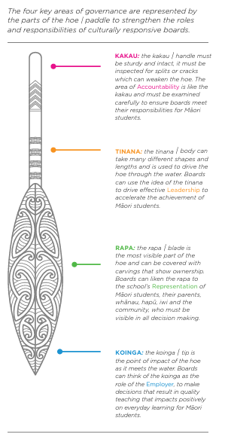
TE HAUTŪ
FOR SCHOOL BOARDS
Hautū 2021 is the New Zealand School Trustees Association’s Māori Cultural Responsiveness Self-Review tool, designed to help school boards implement Te Tiriti o Waitangi. The framework uses a hoe (paddle) metaphor to assess governance across four key areas—accountability, leadership, representation, and impact—to accelerate Māori student success.
https://nzstaworkbooks2021.s3.ap-southeast-2.amazonaws.com/Hautu_2021_FINAL.pdf

Slide 24


Ngā Mātāpono:
Tribunal Tiriti Principles referred to in past reports include: tino rangatiratanga, partnership, reciprocity/ mutual benefit, active protection, good government, equity and redress.
otection, good government, equity and redress.
Notes:
He aha tēnei?

Slide 25
Ngā Mātāpono:
Tribunal Tiriti Principles referred to in past reports include: tino rangatiratanga, partnership, reciprocity/ mutual benefit, active protection, good government, equity and redress.
otection, good government, equity and redress.
TE WHAI HUA KOTAHI -
Mutual benefit / reciprocity
Notes:
te mātāpono o te whai hua kotahi / the principle of mutual benefit

Slide 26
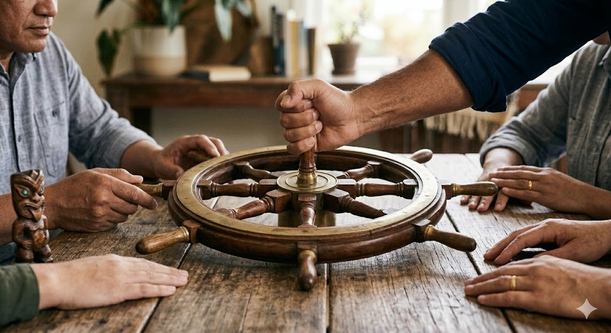
Ngā Mātāpono:
Tribunal Tiriti Principles referred to in past reports include: tino rangatiratanga, partnership, reciprocity/ mutual benefit, active protection, good government, equity and redress.
otection, good government, equity and redress.
Notes:
He aha tēnei?

Slide 27
Ngā Mātāpono:
Tribunal Tiriti Principles referred to in past reports include: tino rangatiratanga, partnership, reciprocity/ mutual benefit, active protection, good government, equity and redress.
otection, good government, equity and redress.
KĀWANATANGA -
Good Governance
Notes:
te mātāpono o te kāwanatanga / the principle of good government;

Slide 28

Ngā Mātāpono:
Tribunal Tiriti Principles referred to in past reports include: tino rangatiratanga, partnership, reciprocity/ mutual benefit, active protection, good government, equity and redress.
otection, good government, equity and redress.
Notes:
He aha tēnei?

Slide 29
Ngā Mātāpono:
Tribunal Tiriti Principles referred to in past reports include: tino rangatiratanga, partnership, reciprocity/ mutual benefit, active protection, good government, equity and redress.
otection, good government, equity and redress.
HOURUATANGA -
Partnership
Notes:
te mātāpono o te houruatanga / the principle of partnership;

Slide 30
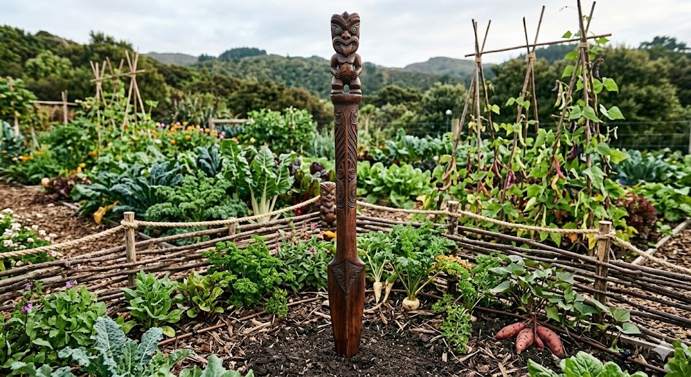
Ngā Mātāpono:
Tribunal Tiriti Principles referred to in past reports include: tino rangatiratanga, partnership, reciprocity/ mutual benefit, active protection, good government, equity and redress.
otection, good government, equity and redress.
Notes:
He aha tēnei?

Slide 31
Ngā Mātāpono:
Tribunal Tiriti Principles referred to in past reports include: tino rangatiratanga, partnership, reciprocity/ mutual benefit, active protection, good government, equity and redress.
otection, good government, equity and redress.
TINO RANGATIRATANGA - Absolute Authority
Notes:
Tino Rangatiratanga:This is about chieftainship, sovereignty, and autonomy.

Slide 32
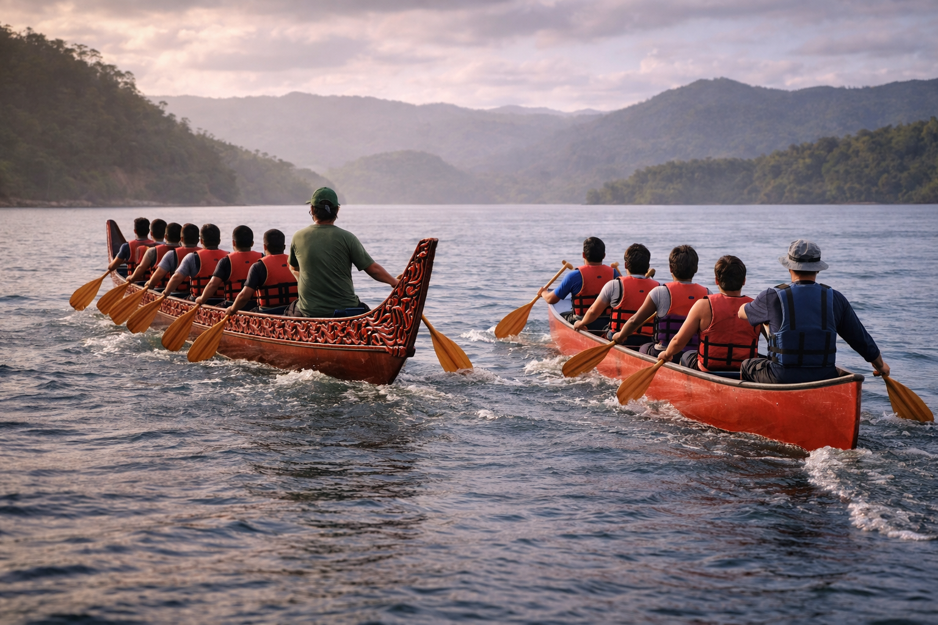
Ngā Mātāpono:
Tribunal Tiriti Principles referred to in past reports include: tino rangatiratanga, partnership, reciprocity/ mutual benefit, active protection, good government, equity and redress.
otection, good government, equity and redress.
Notes:
He aha tēnei?

Slide 33
Ngā Mātāpono:
Tribunal Tiriti Principles referred to in past reports include: tino rangatiratanga, partnership, reciprocity/ mutual benefit, active protection, good government, equity and redress.
otection, good government, equity and redress.
MANA TAURITE -
Equity
Notes:
te mātāpono o te mana taurite / the principle of equity

Slide 34
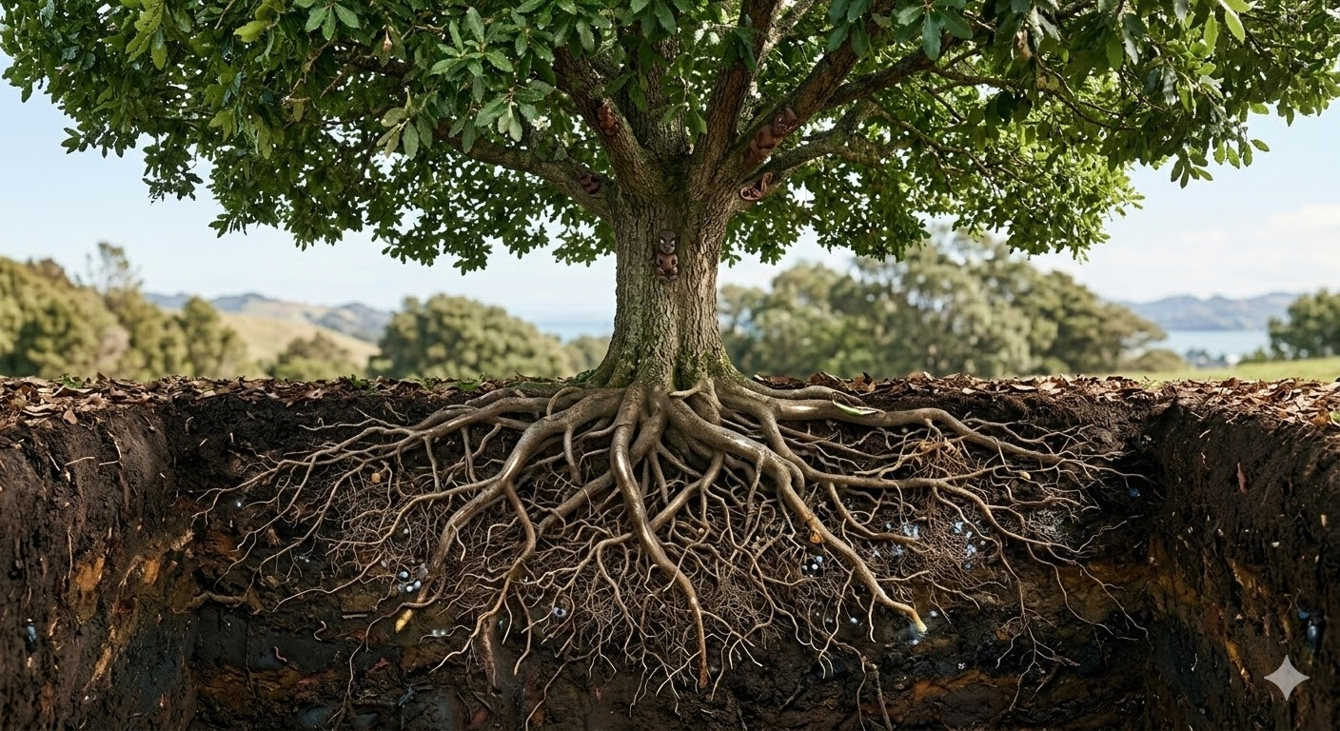
Ngā Mātāpono:
Tribunal Tiriti Principles referred to in past reports include: tino rangatiratanga, partnership, reciprocity/ mutual benefit, active protection, good government, equity and redress.
otection, good government, equity and redress.
Notes:
He aha tēnei?

Slide 35
Ngā Mātāpono:
Tribunal Tiriti Principles referred to in past reports include: tino rangatiratanga, partnership, reciprocity/ mutual benefit, active protection, good government, equity and redress.
otection, good government, equity and redress.
MATAPOPORE MOROKI -
Active Protection
Notes:
te mātāpono o te matapopore moroki / the principle of active protection

Slide 36
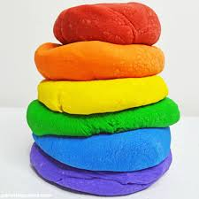
Pokepoke Parāoa
Playdough Pictionary
Notes:
S19-25 - 15mins

Slide 37
Reflecting on Te Tiriti everyday practices in the profession
Christine Weepu - Te Reo a Rohe (Te Tai o Poutini, West Coast)

Slide 38
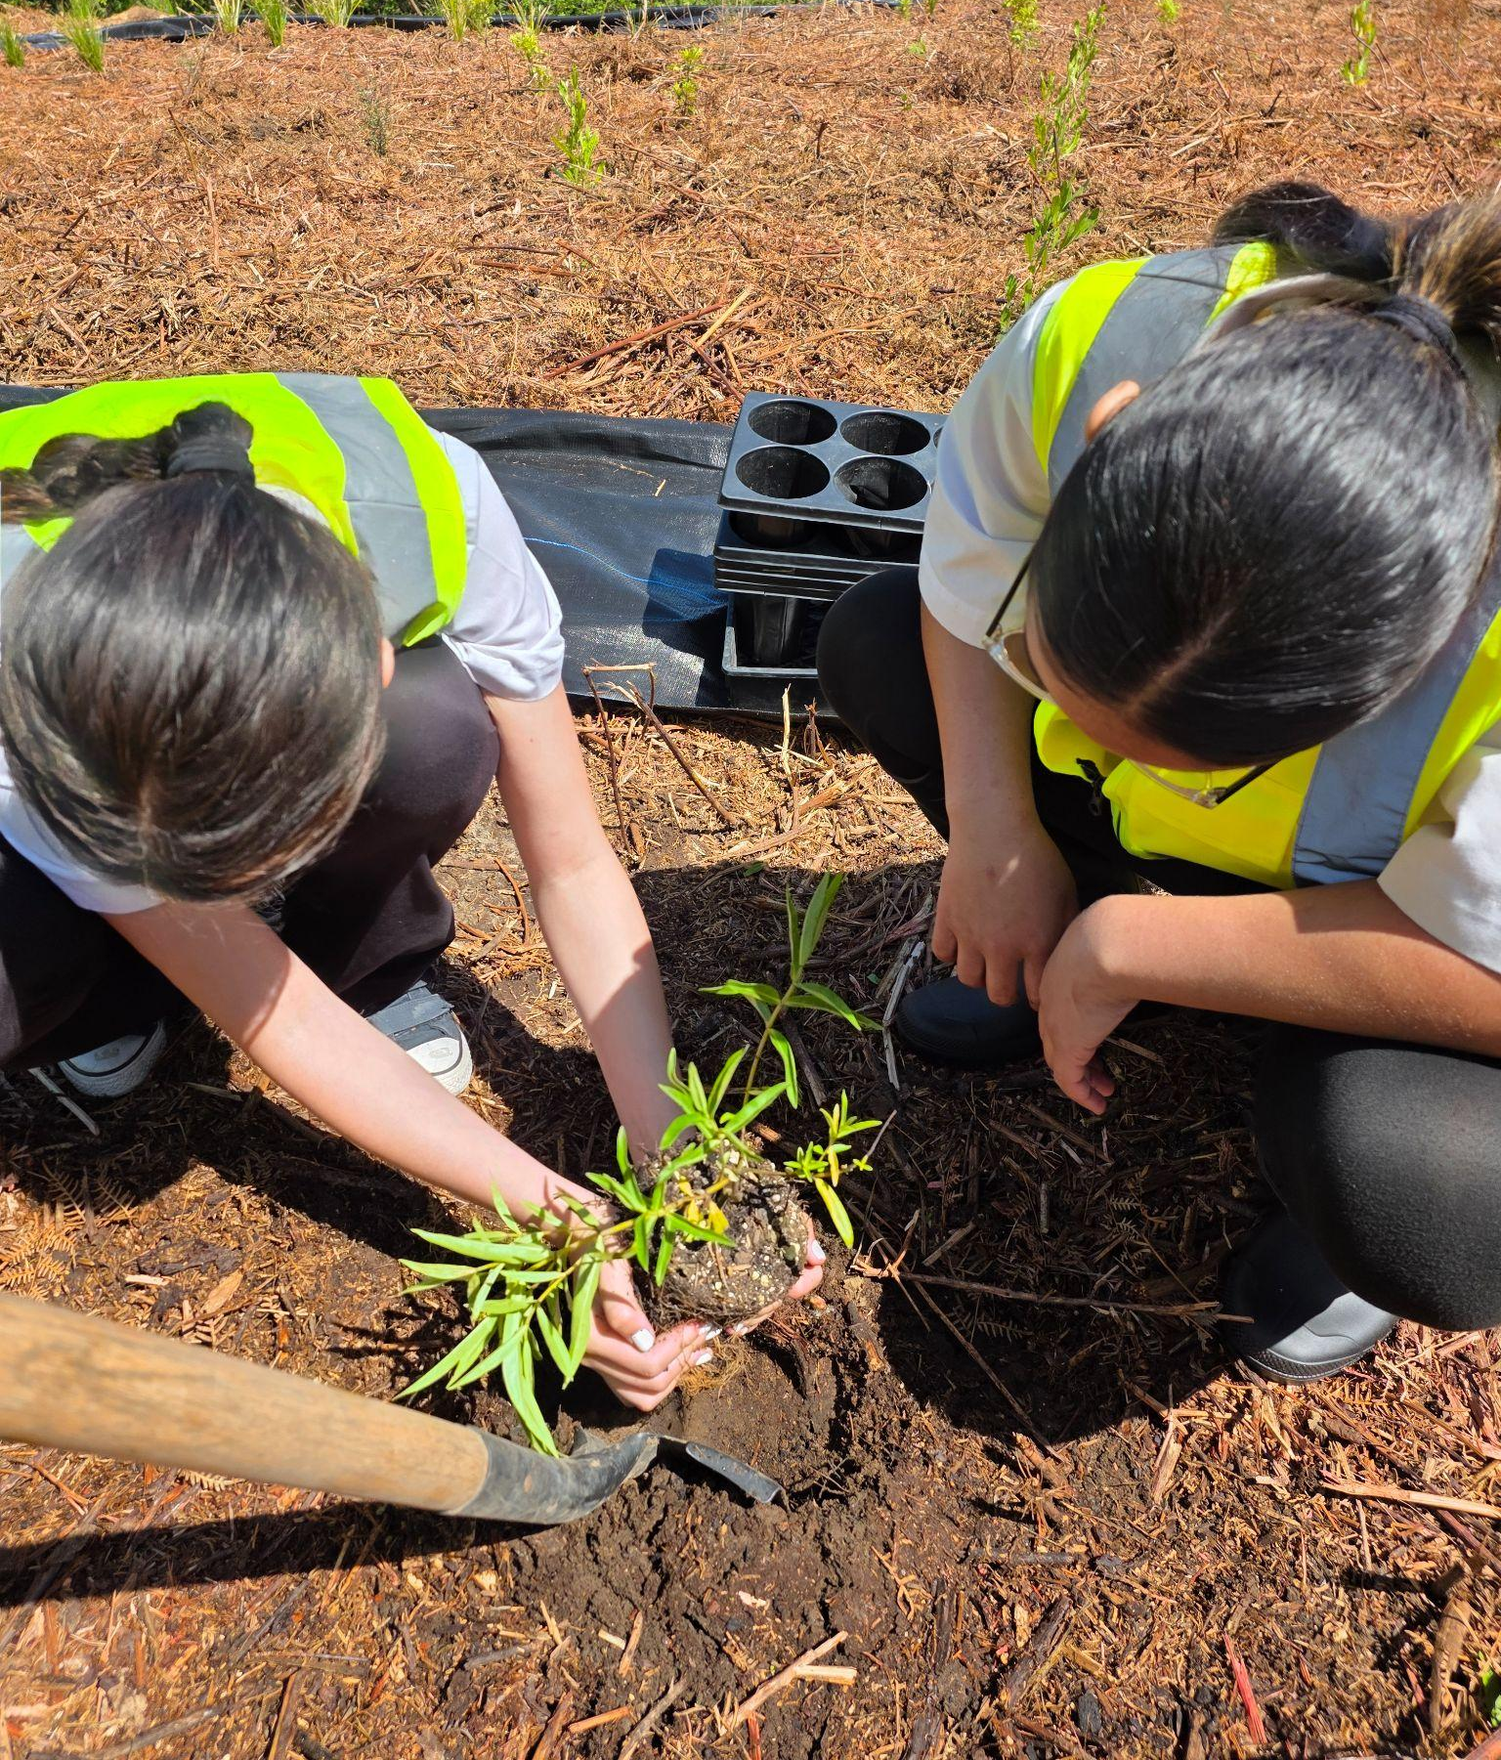
Activity - Suggested Practices
in the learning community
Have a look at the handout.
Which of the practices can you see yourself doing
  as an individual
  as a kaiako
  as a community member
What examples might be your next steps?
Take a photo of your top 3 to keep on your phone as a reminder :)

Slide 39
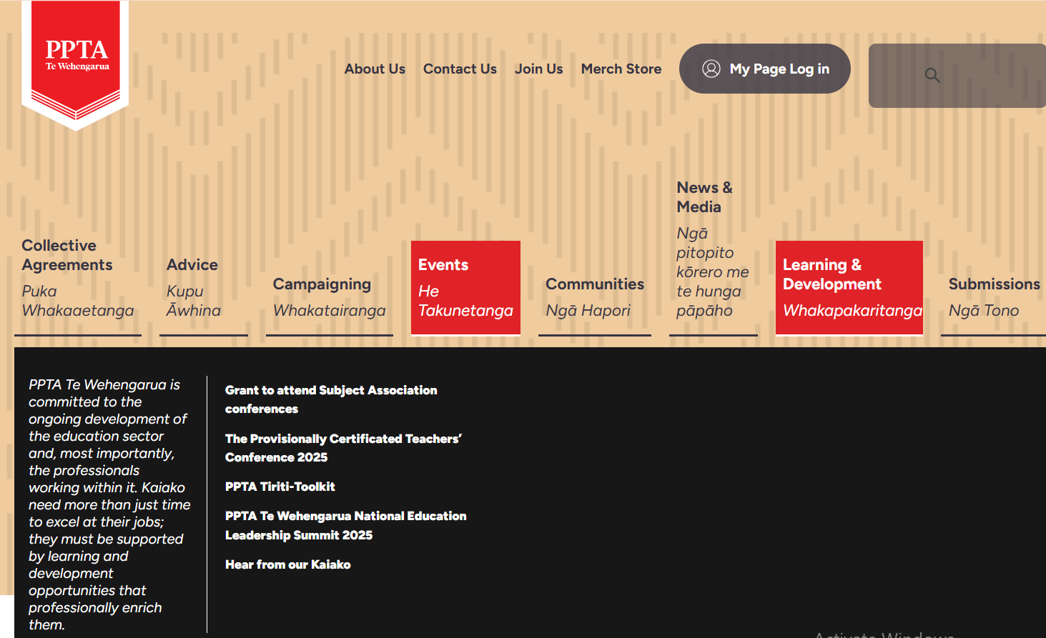
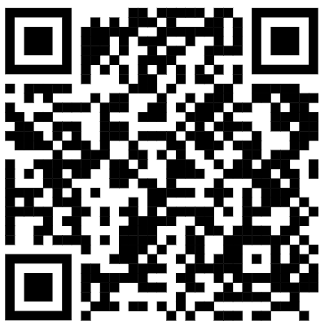
Affirming and advancing Te Tiriti o Waitangi is one of our key constitutional objectives.
This is a new and growing resource that was put together to support kaiako and develop their understanding of Te Tiriti. These resources have been curated by the The Te Tiriti o Waitangi Komiti, together with Te Huarahi Māori Motuhake and Te Reo a Rohe.
PPTA Tiriti-Toolkit
The toolkit is on the PPTA site here,
under “Learning & Development”.
Notes:
5MINS

Slide 40
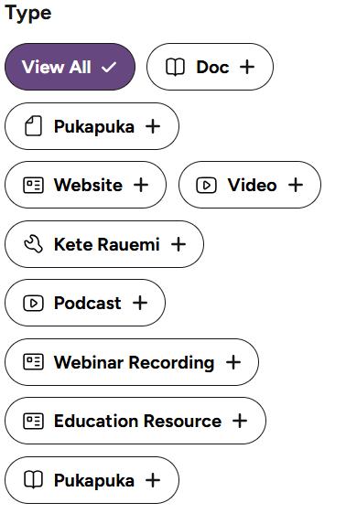
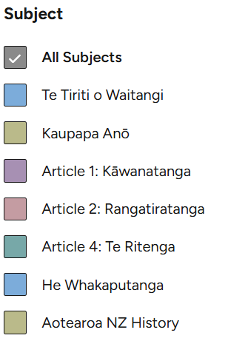
PPTA Tiriti-Toolkit
Filters are found along the left side of your the page.
Filter by subject or the type of resource.
Select your resource, scroll down and you will see a hyperlink to your selected resource.
Notes:
2MINS

Slide 41
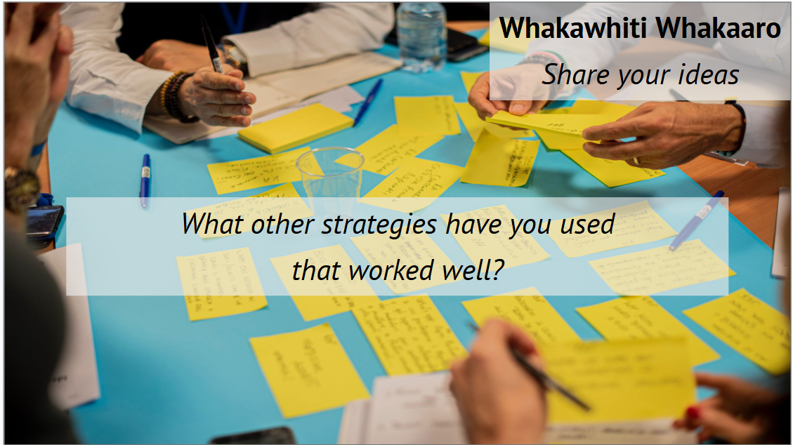
What other strategies have we come across to help be Te Tiriti active?
When you get the time, we are leaving a few of our favs
here for you to look at…
Notes:
https://groundwork.org.nz/wp-content/uploads/2024/03/Te-Tiriti-personal-actions.pdf

Slide 42
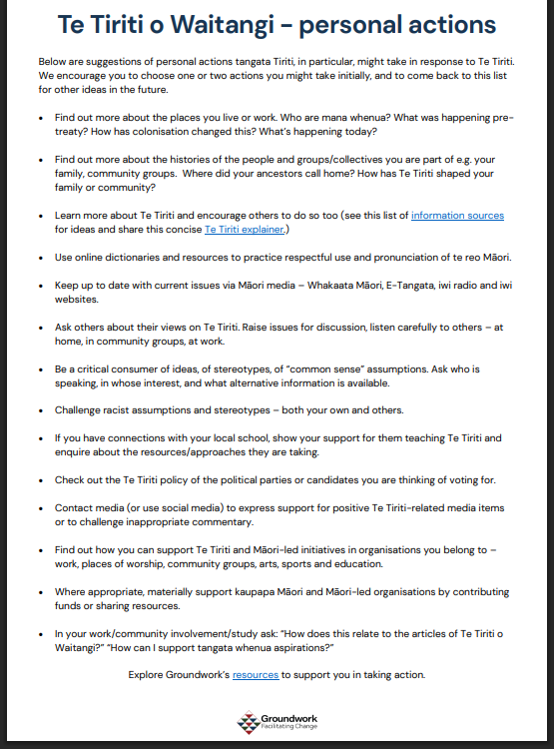
Personal actions
(from Groundwork)
Te Tiriti information sources | Groundwork
Te Tiriti Explainer - Groundwork

Slide 43

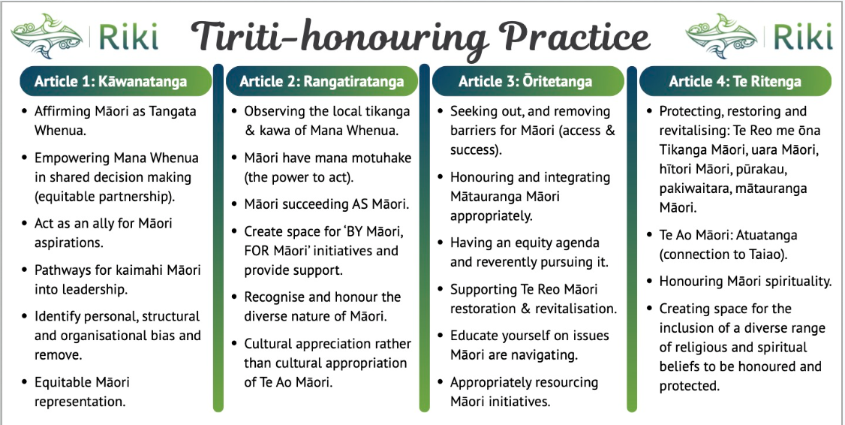

Slide 44
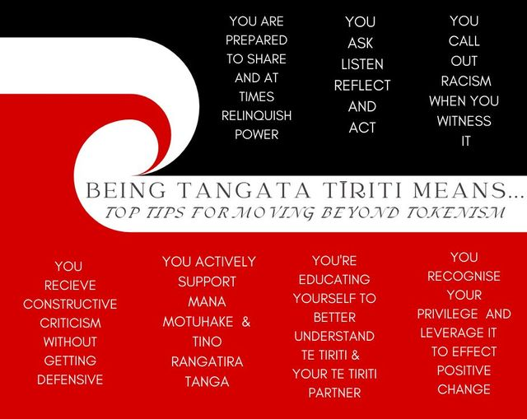
K.NGATA

Slide 45

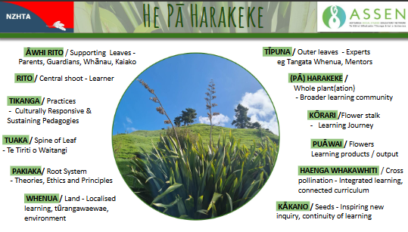
A planning process for a Te Tiriti honouring approach to curriculum implementation
HPH - supporting transformative change for thriving communities
Mātauranga Māori | NZHTA

Slide 46


REFLECTIONS - PLS POP IT ON A POST-IT
ONE CONCEPT I WANT TO EXPLORE FURTHER IS…
WHAT STOOD OUT FOR ME WAS…
SOMETHING NEW I LEARNED TODAY IS…
I WILL WORK ON
NEXT TIME YOU COULD CONSIDER…
I LIKED HOW…
I WOULD HAVE PREFERRED…
Notes:
2 mins

