Slide 1

Tomorrow’s Schools

Slide 2
Tomorrow’s School Taskforce
Governance, management and administration of the schooling system must be founded on
Te Tiriti o Waitangi and the rights of the child
To enable every learner to belong
Being holistic and promoting wellbeing
Gives success to students whoever they are and wherever they are in the system

Slide 3


Slide 4
Hubs
Teachers and principals employed by hubs
Te Tiriti o Waitangi
Equity index replacing decile
NZQA merged with MoE
Principals on fixed-term appointments
ERO becomes EEO – system evaluation

Slide 5


Slide 6
Hubs - gone
Principals on fixed term contracts - gone
Secondments for teachers - gone
NZQA
Teachers employed by BoT
Education Support Agency
ERO becomes EEO – system evaluation

Slide 7


Slide 8
More responsive, accessible and integrated local support to schools and early learning services
Stronger arrangements to underpin principal leadership of the schooling system
A better balance between local and national responsibilities for school property and network provision.

Slide 10
1. Networked, responsive
Education Service Agency
Monitoring and evaluation

Slide 11
Education Support Agency
central, regional, local
supporting teaching and learning
focus on those the system currently does not serve well: Māori, Pacific, those with disabilities and/or learning support needs, and those from disadvantaged backgrounds
strengthening leadership

Slide 12
Monitoring and evaluation
individual school reviews provide important information for schools, whānau and communities.
strengthen the capability of schools to undertake self-evaluation and continuous improvement

Slide 13
2. Leadership
Leadership advisors
Eligibility criteria principals
Principals where they are needed

Slide 14
3. The network of schooling
Responsibilities for property
Strategic
  – Te Tiriti o Waitangi
  - Maori medium pathway
Enrolment zones

Slide 15
Five other objectives
Learners at the centre
Barrier-free access
Quality teaching and leadership
Future learning and work
World class inclusive public education

Slide 16
4. Learners at the centre
Role of BOTS
Every student is able to attain their highest possible educational standard
School - physically and emotionally safe, student rights, reasonable steps to eliminate racism, stigma, bullying and discrimination
Inclusive of and caters for students with differing needs
Gives effect to Te Tiriti

Slide 17
4. Learners at the centre
School gives effect to Te Tiriti
Ensure plans, policies and local curriculum reflect local tikanga, mātauranga Māori and te ao Māori;
Provide tikanga Māori and te reo Māori;
Achieve equitable outcomes for Māori students.

Slide 18
4. Learners at the centre
Complaints and dispute resolution panels

Slide 19
5. Barrier free access
Equity index - replace decile funding
Support for learners with disabilities and/or learning support needs
Full-service site - wraparound services in socio-economically disadvantaged communities
Transitions - a secure and trustworthy information sharing platform
Joint secondary school-tertiary learning

Slide 20
6. Quality teaching and leadership
Education Workforce Strategy
Strengthening BOT – support and guidance
Code of Conduct for BOT
Support new teachers – National Beginning Teacher Grant, Voluntary Bonding Scheme, new requirements for ITE

Slide 21
7. Future of learning and work
Curriculum centre - leads, develops and supports curriculum development and delivery
Flexible learning – VLNs, Te Kura

Slide 22
8. World class inclusive education
Develop and improve the Kāhui Ako
Work with the Accord to consider resourcing for staffing entitlements

Slide 23
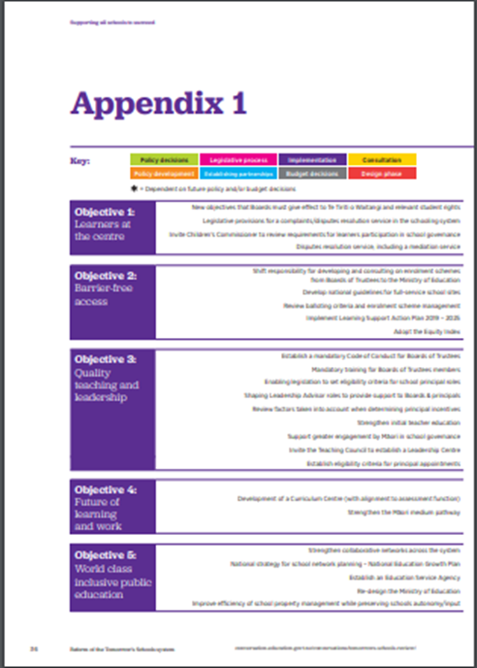
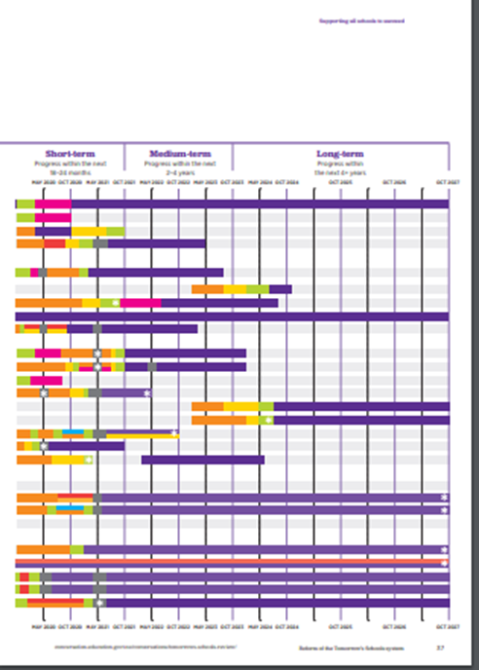
Work plan

Slide 24
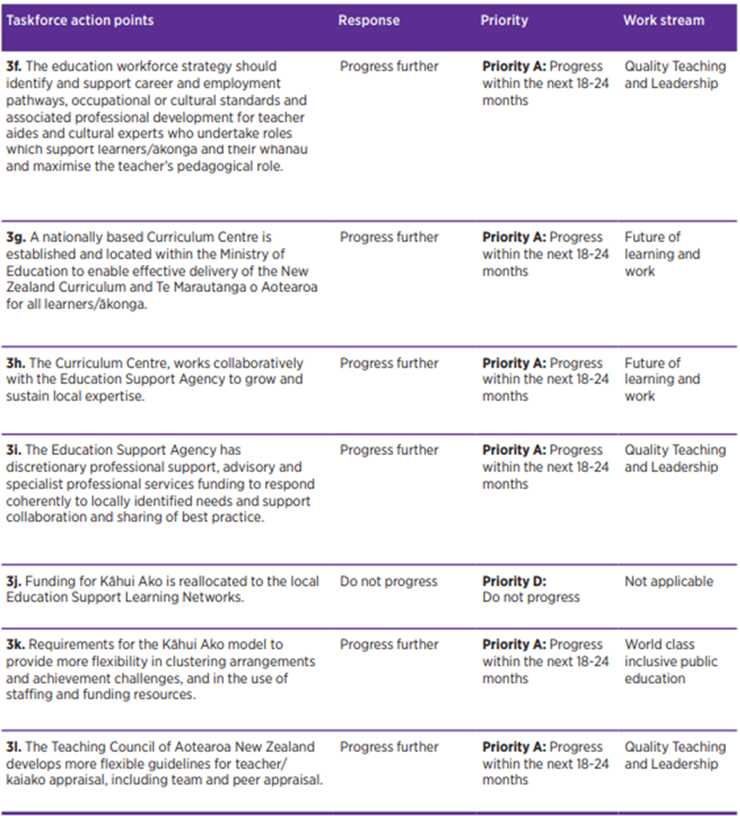

Slide 25

Comments

Slide 26
How will these changes happen?
Legislation
Ministry
ESA
Curriculum Unit
Accord

Slide 27
How will these changes happen?
Legislation
Ministry
ESA
Curriculum Unit
Accord

Slide 28
MoE
Internal restructure

Slide 29
Education Service Agency

Slide 30
Education Service Agency
PPTA response
What elements are critical for the ESA to be successful?
What services should the ESA be providing?
Of these what would you prioritise?
How should the ESA operate?

Slide 31
Tomorrow’s Schools – gone?

