Slide 2
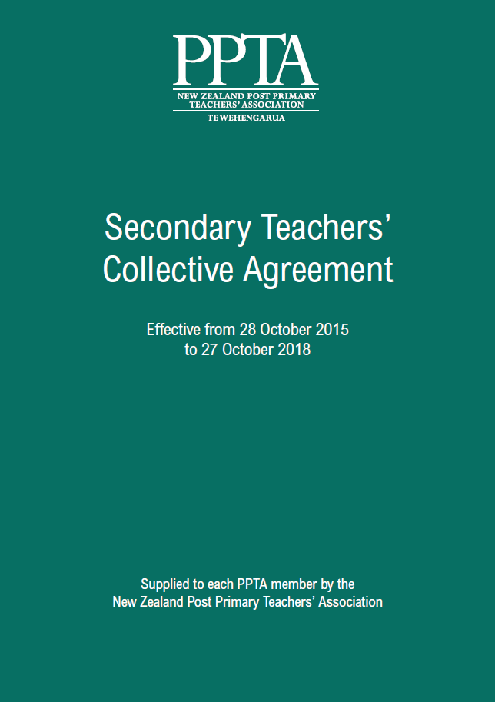
Secondary teachers’ collective negotiations
Notes:
Our collective agreement negotiations are a way for us to get the conditions right to fix teacher shortages, improve pay, and address excessive workload.

Slide 3
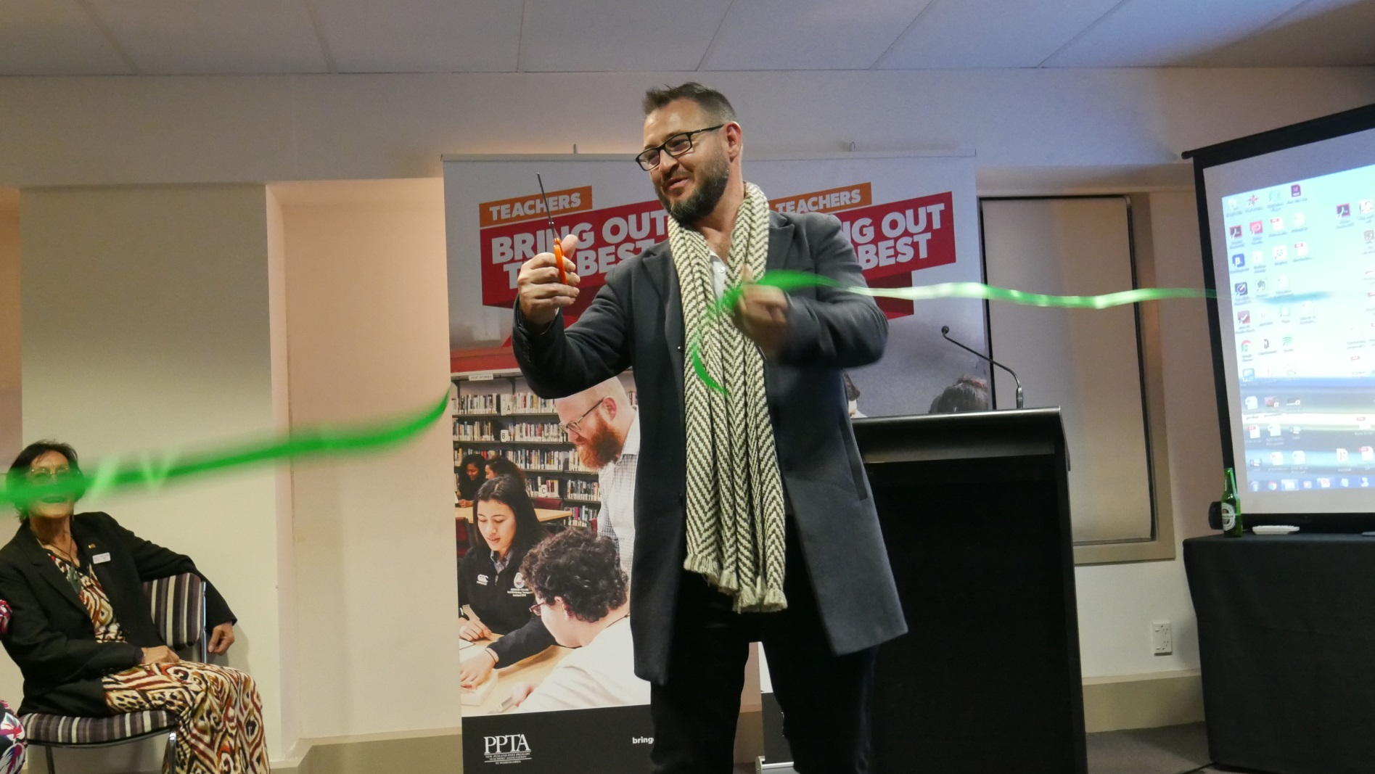
Notes:
To support our campaigns through 2018-9, the PPTA launched a "Bring out the Best" campaign in August, with terrific support from union, political, and education sector representatives.
The campaign aims to raise public support for secondary teachers and give people a glimpse into the real lives of the people who make the profession what it is.

Slide 4
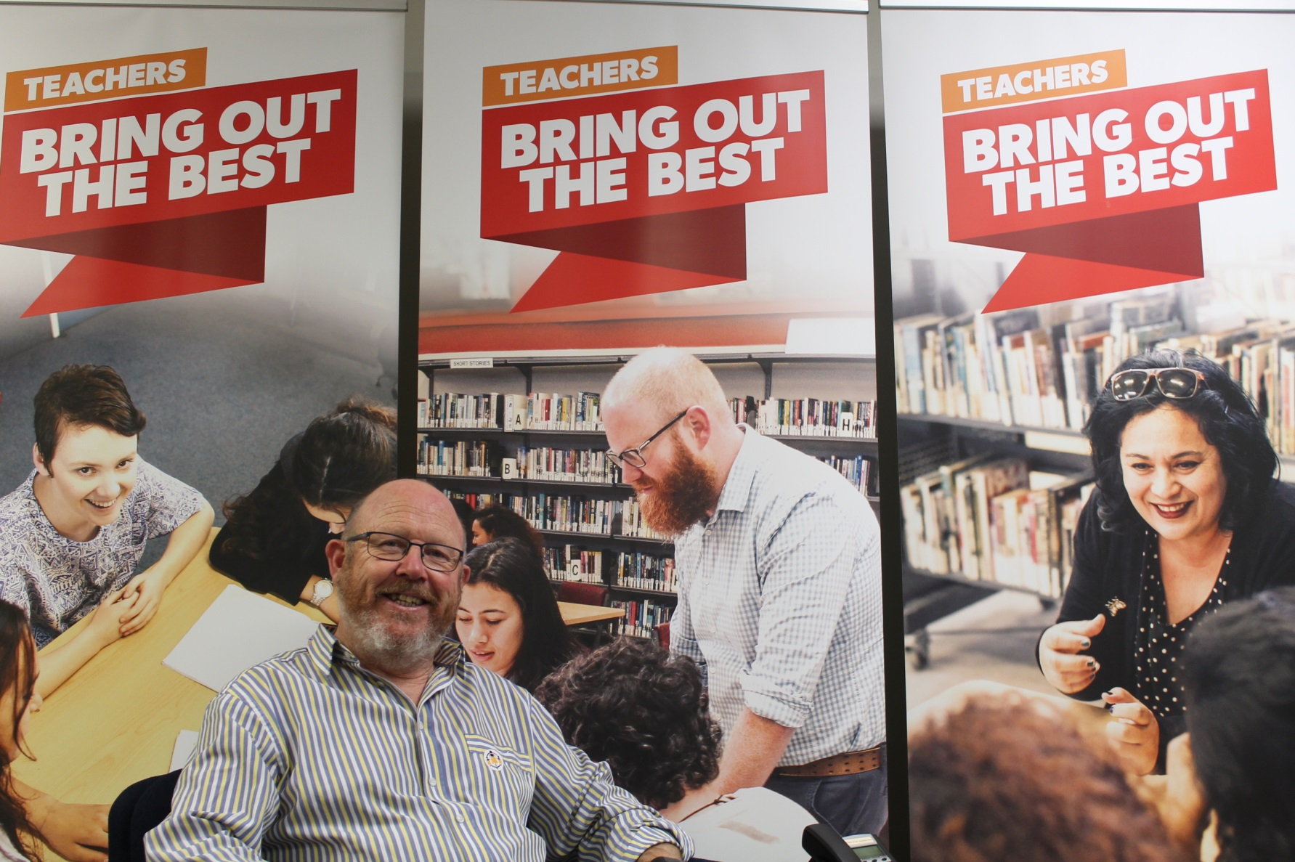
Notes:
To highlight the wonderful work teachers do, real teachers have been featured on bus shelter posters, in newspaper ads and even at movie theatres. With unprecedented teacher shortages and very little progress happening in our negotiations with the government, we need to work together to achieve our goals.

Slide 5
Facebook
PPTA members – bringing out the best
Web updates
ppta.org.nz/members
Notes:
If you would like to keep up with the latest from the campaign, you can join the closed facebook group for PPTA members and keep an eye on the members-only area of the PPTA website.

Slide 6
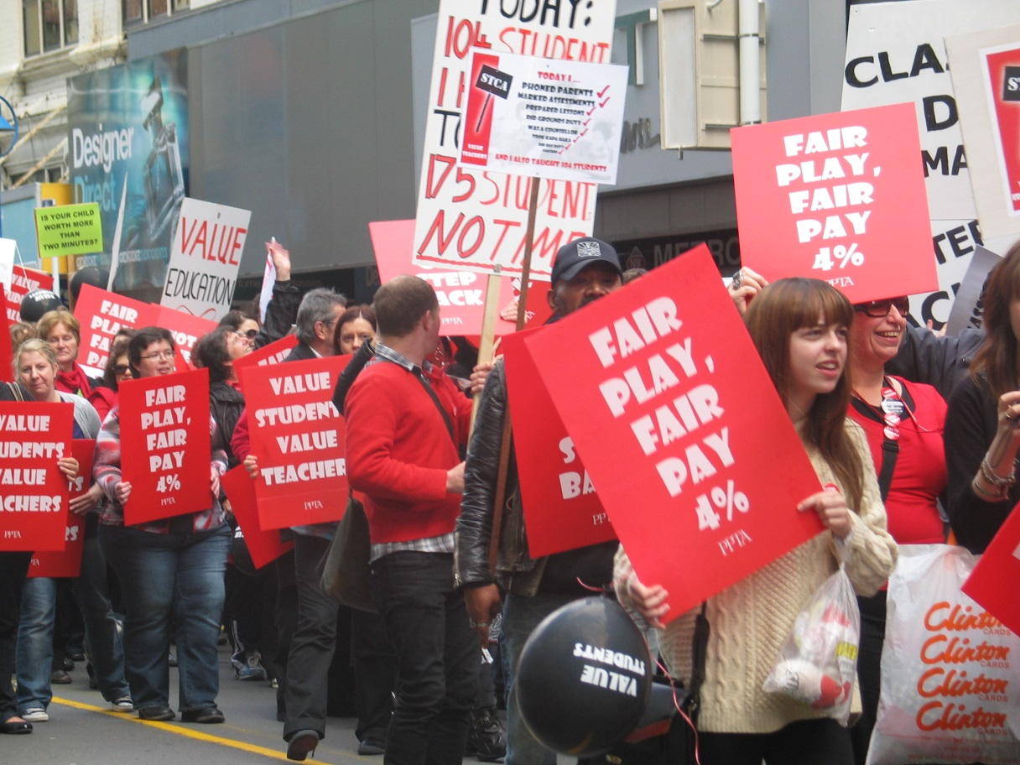
Preparing for strike action
Notes:
PPTA members recently voted to authorise industrial action in term 1, 2019. That may or may not happen, depending on whether we get a satisfactory offer from the government to settle our secondary teachers’ collective agreement. Members also voted to develop a plan for further industrial action, which may involve more strike days later in the year.
Not all teachers have the financial stability to weather the loss pay. It’s our responsibility to show solidarity and do as much as we can to support every member.

Slide 7
What PPTA branches can do
Find out from your regional team whether they have funds already set aside for supporting striking colleagues.
Create a branch hardship fund and ask your colleagues and non-members to donate what they can. Either one-off or on-going donations are helpful.
Use the strike calculator on the member-only PPTA site to figure out how much salary you might forgo in a one-day strike.
Talk with your fellow members about any concerns they might have around industrial action and reassure them that we are all in this together.
Notes:
What branches can do

Slide 8
What individual members can do
Try to save a little from each pay before the strike
Secure or extend your overdraft facilities.
Approach your bank and other organisations to which you make regular payments and seek deferral or reduction of payments, if you need to.
Contribute to a branch hardship fund to assist colleagues who will need assistance.
Defer spending on non-essential items.
Conserve as much of your pay as possible while the campaign is on.
If you have school-aged children, contact their school and seek deferral of school fees/donations/trip costs, etc., until settlement of the collective.
Claim all collective agreement allowances from the school – e.g. travel reimbursements.
Call in debts owed to you by others.
Get advice from the Budget Advice Service in your area.
Ask your branch or regional committee for help if you need it.

Slide 9
STRONGER TOGETHER
Notes:
It’s important that we stick together so we can bring out the best for every teacher, every child and the education system we need, now and for the future.

